Slide 1
TEN TIPS AND TRICKS TO LEARN THE DAA
ANTHONY S UNGER, MD
WASHINGTON, DC

Slide 2
ANTHONY S UNGER, MD
DISCLOSURES
  INNOMED—ROYALTIES
  SIGNATURE ORTHOPAEDICS- ROYALTIES
  J OF ARTHROPLASTY-EDITORIAL BOARD
  ARTHROPLASTY TODAY-EDITORIAL BOARD

Slide 3
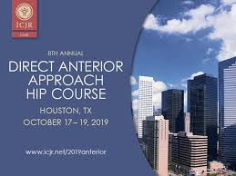
#1 ATTEND AT LEAST TWO CADAVER COURSES

Slide 4

#2 ARRANGE A PROCTOR VISIT

Slide 5
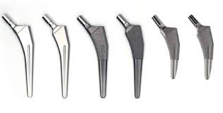
#3 DO NOT CHANGE YOUR IMPLANTS

Slide 6
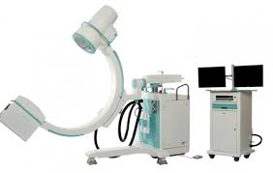
#4 USE IMAGING

Slide 7
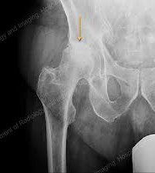
#5 DO THE EASY CASES FOR FIRST 20
THIN FLEXIABLE FEMALES
TALL THIN MALES
NO PROTRUSIO
LIMITED OSTEOPHYTES

Slide 8

#6 ALLOW ADEQUATE TIME FOR CASE- 2 HRS MIN

Slide 9
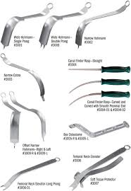
#7 BECOME FAMILIAR WITH INSTRUMENTS BEFORE CASE-SAW BONES

Slide 10
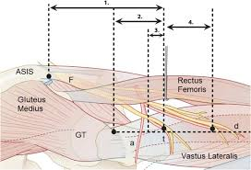
#8 UNDERSTAND THE BAILOUTS—SET TIME LIMIT BEFORE YOU GIVE UP

Slide 11
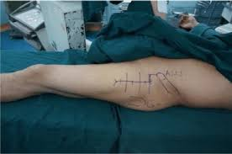
#9 USE A BIG INCISION

Slide 12

#10 STICK WITH IT—DON’T GIVE UP EASILY

Slide 13
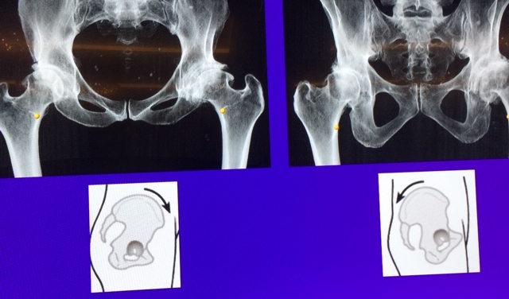
BONUS: SUPINE POSITION INFLUENCES CUP POSITION

Slide 14
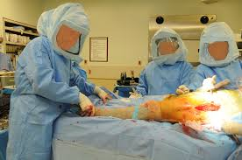
THANK YOU

