Slide 1
PSOAS TENDONITIS IN DAA
ANTHONY S UNGER, MD
WASHINGTON, DC

Slide 2
ANTHONY S UNGER, MD
DISCLOSURES
INNOMED—ROYALTIES
SIGNATURE ORTHOPAEDICS-ROYALTIES
J OF ARTHROPLASTY-EDITORIAL BOARD
ARTHROPLASTY TODAY-EDITOR BOARD

Slide 3
IS ANTERIOR GROIN PAIN A PROBLEM AFTER DAA???
YES---BUT PREVENTABLE

Slide 4
PSOAS TENDONITIS=GROIN PAIN

Slide 5
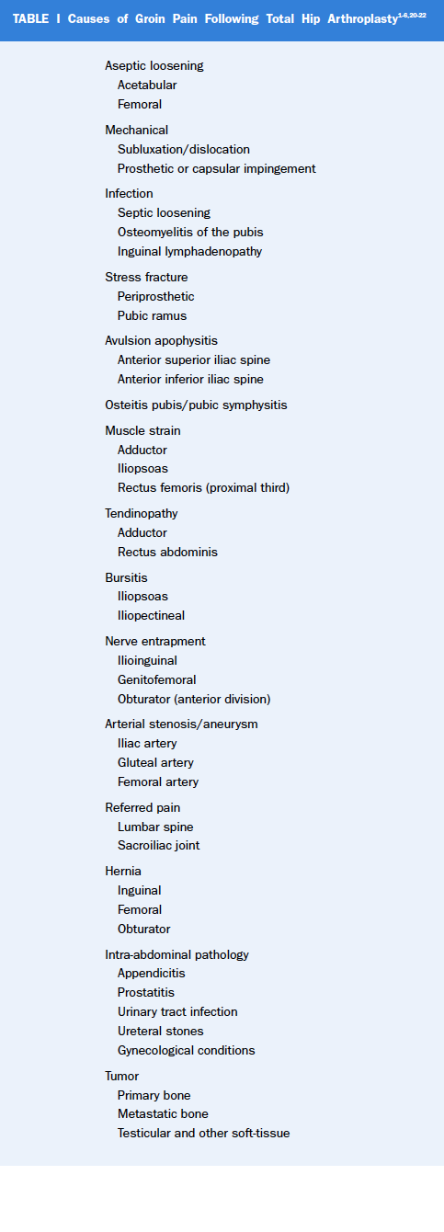
IDENTIFY TO CAUSE OF GROIN PAIN

Slide 6
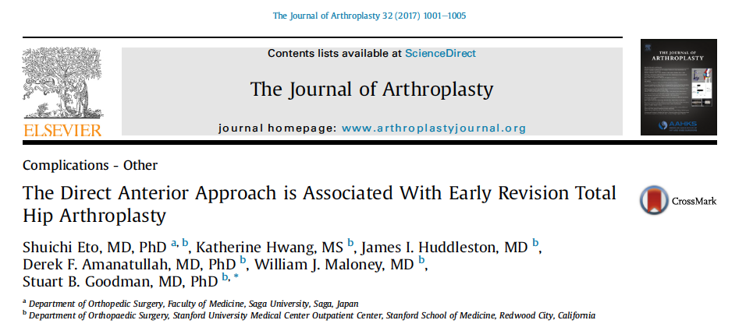

Slide 7
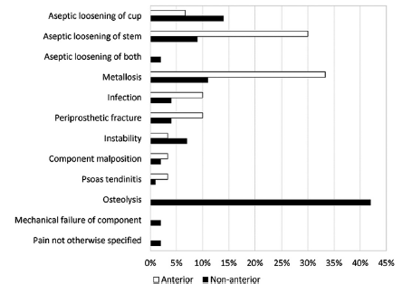

Slide 8
ANTERIOR OVERHANG>8 MM
Iliopsoas Impingement After Primary Total Hip Arthroplasty: Operative and Nonoperative Treatment Outcomes
Chalmers, Brian P.; Sculco, Peter K.; Sierra, Rafael J.; Trousdale, Robert T.; Berry, Daniel J.
JBJS. 99(7):557-564, April 5, 2017.
doi: 10.2106/JBJS.16.00244

Slide 11
HISTORY
ANTERIOR GROIN PAIN UPON RISE FROM CHAIR OR STAIR CLIMB
USUALLY AFTER 6 -12 WEEKS POST OP

Slide 12
PHYSICAL EXAM
PAINLESS PASSIVE ROM
PAIN ON SLR OR ACTIVE FLEXION
PAIN ON PALPATION OVER PSOAS TENDON

Slide 13
IMAGING
XRAY-AP AND X-TABLE LATERAL
MRI-MARS
ULTRASOUND GUIDED INJECTION

Slide 14
PREVENTION
HOLD PT UNTIL 6 WEEKS
NO OPEN CHAIN HIP FLEXION IN FIRST 6 WEEKS
WORK WITH KNOWLEDGABLE PT

Slide 15
PREVENTION
NO ANTERIOR OVERHANG
BURY CUP
SAVE MEDIAL CAPSULE??

Slide 16
PT for DAA is DIFFERENT !!

Slide 18
NON-OP RX
NSAI
PT
GUIDED INJECTION
STEROID
BOTOX
PRP??

Slide 19
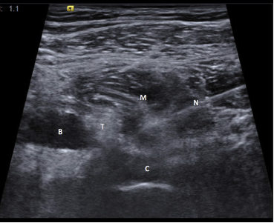

Slide 20
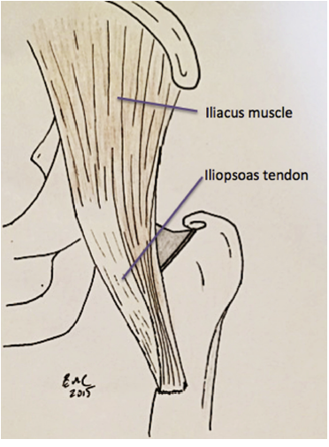

Slide 21
Tenotomy successful!!

Slide 23
ANTERIOR OVERHANG>8 MM
Iliopsoas Impingement After Primary Total Hip Arthroplasty: Operative and Nonoperative Treatment Outcomes
Chalmers, Brian P.; Sculco, Peter K.; Sierra, Rafael J.; Trousdale, Robert T.; Berry, Daniel J.
JBJS. 99(7):557-564, April 5, 2017.
doi: 10.2106/JBJS.16.00244

Slide 24
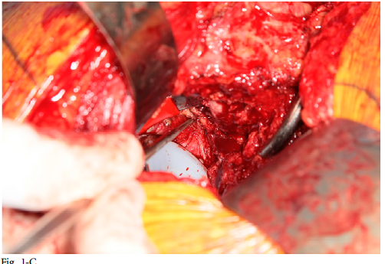

Slide 25
REVISE CUP
Iliopsoas Impingement After Primary Total Hip Arthroplasty: Operative and Nonoperative Treatment Outcomes
Chalmers, Brian P.; Sculco, Peter K.; Sierra, Rafael J.; Trousdale, Robert T.; Berry, Daniel J.
JBJS. 99(7):557-564, April 5, 2017.
doi: 10.2106/JBJS.16.00244

Slide 26
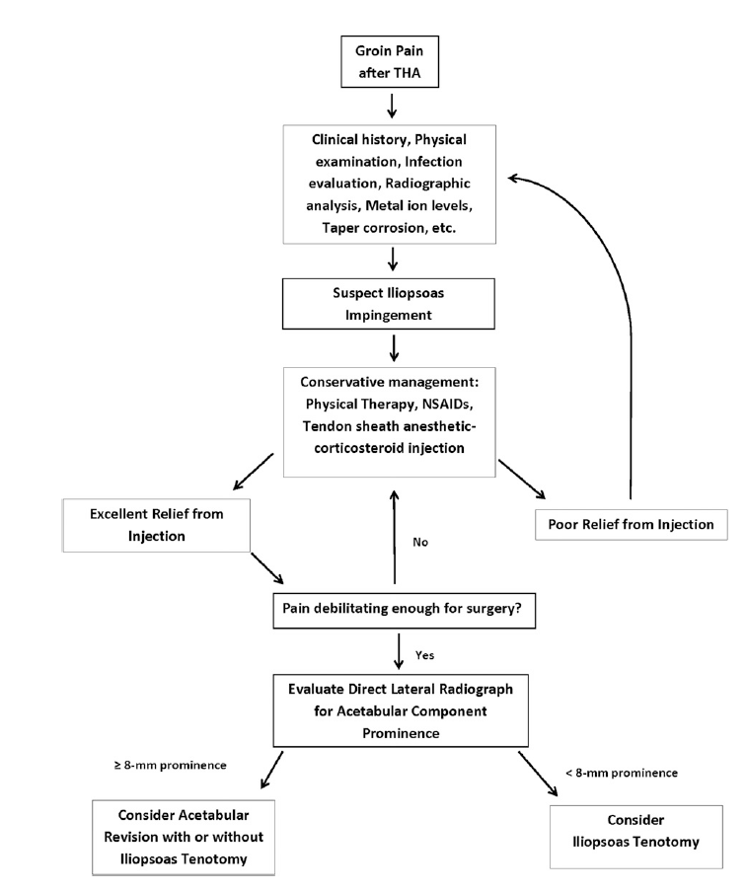

Slide 27
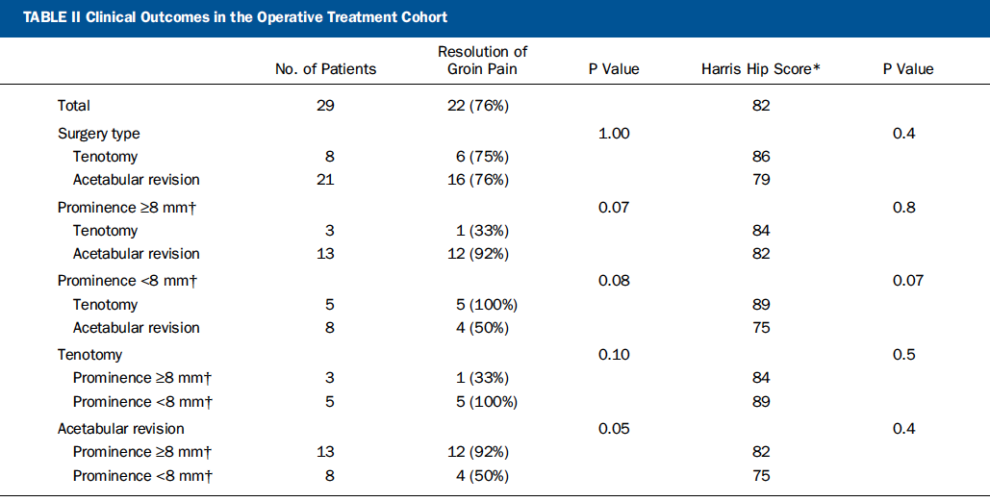

Slide 28
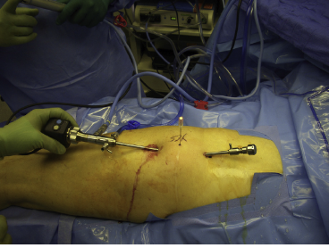
HIP SCOPE

Slide 29
93% successful!!

Slide 30
CONCLUSION
IN OR-- WATCH OUT FOR ANTERIOR IMPINGEMENT
HOLD THE PT
FOLLOW THE ALGORITHIM : RELEASE PSOAS for <8mm AND/OR REVISE CUP FOR >8mm in CHRONIC CASES

