Slide 1
TOTAL HIP REPLACEMENT IN THE ELDERLY
ANTHONY S UNGER, MD
WASHINGTON, DC

Slide 2
ANTHONY S UNGER, MD
DISCLOSURES
INNOMED—ROYALTIES
SIGNATURE ORTHOPAEDICS- ROYALTIES
J OF ARTHROPLASTY-EDITORIAL BOARD
ARTHROPLASTY TODAY-EDITORIAL BOARD

Slide 3
THE ELDERLY----80 YRS AND ABOVE

Slide 5
Facts
1. What is the average life expectancy for someone born in U.S. in 1900? In 2015??
2. How old is the oldest living person ever recorded?

Slide 6
life expectancy(us) by birth year
1900------- 47
2015------- 79

Slide 7
Oldest Person Age=122

Slide 8
EXPANDING POPULATION OF ELDERLY PATEINTS
POPULATION OF >65 YO GROWING 15.1% VS 9.7%
>85 DOUBLES BY 2030
PERCENT OF POPULATION
2.5% BY 2030
4.5% BY 2050

Slide 9
RESULTS OF THA FAVORABLE
PAGNANO-MAYO EXPERIENCE
MEDICAL CO-MORBITIES COMMON
MOST STEMS CEMENTED
AT 4.2 YO HSS SCORES IMPROVED
9/65 HAD COMPLICATIONS
25% IN ICU

Slide 10
More complications!!

Slide 11
More complications!!

Slide 14
Cost Effective!!

Slide 15
ISSUES WITH ELDERLY PATIENTS
PERIPROSTHETIC FRACTURES
MORTALITY/CO-MORBIDITES
EXTENDED STAY
DISLOCATION
COGNITIVE DYSFUNCTION

Slide 16
ELDERLY – THA FXS

Slide 17
PERIPROSTHETIC FRACTURES
RATE INTRAOP FROM 0.1- 27.8%
RATE POST OP FROM 0.07-18%
INCREASED RISK WITH OSTEOPOROSIS, RA, PRESS FIT FEMUR, PROXIMAL FEMORAL DEFORMITIES, PREVIOUS SURGERY, REV THA
SIDLER-MAIER ET AL. INT ORTHOP 2015

Slide 18
PERIPROSHETIC FRACTURES
SWEDISH REGISTRY
HIGHER MORTALITY
EST PROBABILITY OF DEATH 3.9% IN MEN, 2.2% IN WOMEN

Slide 19
PERIPROSHETIC FRACTURE
FINNISH REGISTRY
HIGHER REVISION AND FAILURE RATE WITH CEMENTLESS VS CEMENTED
MORTALITY HIGHER FOR CEMENTLESS BECAUSE OF FRACTURES
JAMSEN ET AL CORR, 2014

Slide 20
CEMENT OR CEMENTLESS
DATA SUPPORTS CEMENTED
LESS FXS WITH CEMENT
CEMENTLESS QUICKER AND SUCCESSFUL IN EXPERT HANDS

Slide 21
ELDERLY—FEMUR FXS
AUTHOR | YR | FX- NO CEMENT | FX CEMENTED | % | F/U
LANGLET | 2014 | 7.4% | 0.9% | 4.1% | 5
PARKER | 2011 | 1.5% | 0% | 0.7% | 3.7
TAYLOR | 2012 | 15% | 1.3% | 8.1% | 2
KHAN | 2002 | 2.5% | 0% | 1.2% | 2.8

Slide 22
ELDERLY -- FXS
DATA SUGGESTS THAT FIRST FX MAY NOT BE LAST
MORTALITY RATE IS HIGH
CEMENTED BETTER THAN CEMENTLESS

Slide 23
ELDERLY PERIPROSTHETIC FXS—”A NEVER ENDING STORY”

Slide 24
ELDERLY -- FXS - ANOTHER ONE!!

Slide 25
ELDERLY- FXS

Slide 26
DAA CEMENT TECHNIQUE
USE CURVED CEMENT STEM
MAKE SURE OFFSET BROACH ARTICULATES
USE POSTERIOR APPROACH IN DIFFICULT PATIENT

Slide 27
NO DIFERRENCE AS LONG AS BONE QUALITY IS GOOD

Slide 28
Cognitive Dysfunction
Beware!!!
Pt does not seem to get it in preop
Interview
Avoid at all costs!!

Slide 29
ELDERLY- COGNITIVE DYSFUNCTION
6.7 % INCIDENCE
68.3 % INCIDENCE OF ADVERSE EVENT IN THESE PATIENTS
SCREEN PEOPERATIVELY WITH MMSE—OR JUST TALK TO THEM
POSTLER ET AL. ARCH GERON GERI 2011

Slide 30
ELDERLY THA- EXTENDED STAY

Slide 31
ELDERLY-EXTENDED STAY
MEAN TIME TO RECOVERY OF INDEPENDENT WALKING WAS 12 DAYS
MEAN LOS WAS 7.5 DAYS(INCLUDING REHAB)
HAMEL ET AL. ARCHINT MED 2008

Slide 32
ELDERLY-THA DISLOCATION

Slide 33
ELDERLY--DISLOCATION
INCREASED RISK
RELATED TO COGNITIVE DYSFUNCTION
INCIDENCE IS 4% WITH POSTERIOR APPROACH
DAA MAY HELP
WOOLSON ET AL J OF ARHROPLASTY 1998

Slide 34
ELDERLY--INFECTION
40000 MEDICARE PTS
ELEVATED RISK IN RA,OBESITY,COAGULOPATHY, ANEMIA,
NO ADDED RISK WITH ELDERLY
BOZIC ET AL 2014

Slide 35
COORDINATED CARE
FAMILY
MEDICAL TEAM
NURSING
PT
SOCIAL WORK

Slide 36
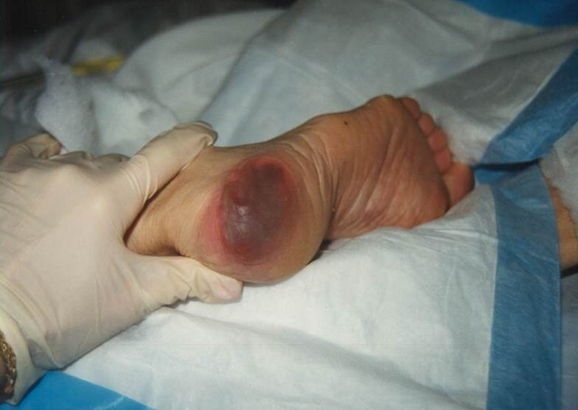
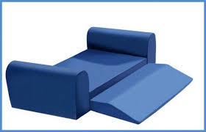
Notes:
.

Slide 37
BE PREPARED!!!

Slide 38
ELDERLY-CONCLUSIONS
EFFECTIVE PROCEDURE
HIGHER COMPICATIONS: DISLOCATION, LOS, FRACTURES, COGNITIVE DYSFUNCTION, MORTALITY
CAREFULLY SCREEN PREOP FOR COGNITIVE DYSFUNCTION
CEMENTED STEMS SHOULD BE CONSIDERED IN DORR C BONE, REDUCE FX RATE

Slide 39
THA IN ELDERLY
THANK YOU!!

