Slide 1
Effect of the Enhanced Recovery After Surgery (ERAS) Perioperative Protocol on Short Term Outcomes of Joint Replacement Surgery
Safa Fassihi M.D.¹, Melissa Soderquist M.D.¹, Sean Kraekel M.D.¹, Anthony Unger M.D.²
¹ The George Washington University Department of Orthopaedic Surgery, Washington DC
² The Johns Hopkins University, Department of Orthopaedic Surgery, Baltimore MD

Slide 2
DISCLOSURES
There are no conflicts or relationships related to the content of this presentation.
I have no disclosures
Royalties and stock options: None
Consulting income: None
Research and educational support: None
Other support: None

Slide 3
Background
ERAS: Multimodal, multi-disciplinary approach for establishing procedure–specific, evidence-based perioperative protocols designed to optimize patient outcomes after surgery
Principles:
Minimize patient’s surgical stress response
Standardized anesthesia protocol
Multimodal pain control (minimize opioids; utilize central, peripheral, and local nerve blockade)
Maintenance of homeostasis (normothermia, goal-directed fluid therapy)
Early feeding and mobilization
Minimize use of tubes, drains, catheters
Prospective database tracking and auditing

Slide 4
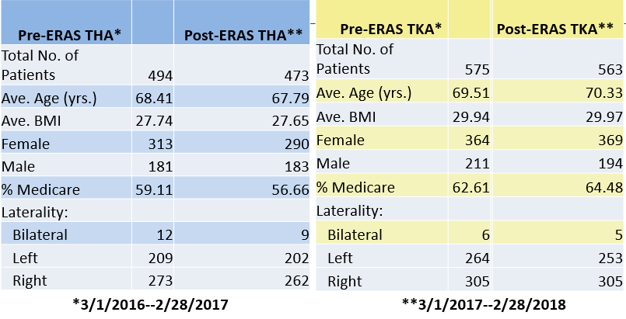
Methods
ERAS protocol collectively instituted March 1, 2017 at 245-bed community hospital (multi-surgeon)
All primary THA & TKA performed in the year preceding and following protocol initiation were included
LOS, opioid use, patient disposition, morbidity, and readmission/return to ED were analyzed
Student’s t-test and chi-square test were used for statistical analysis

Slide 5
Results - THA
 | preERAS | postERAS
LOS (Hours) | 57.8 | 51.9
Opioid Use Day 1 (MME) | 49.5 | 35.4
Overall Opioid Use (MME) | 79.5 | 59.5
IV Opioid Use Day 1 (MME) | 28.6 | 15.2
Overall IV Opioid Use (MME) | 29.5 | 15.6
% of Patients Discharged Home | 80.4 | 82.5
% of Patients with Blood Transfusion | 4.3 | 3.8
% of Patients with Return to ED within 30 days | 5.9 | 6.3
% of Patients with Return to ED within 90 days | 8.51 | 8.88
% of Patients Readmitted within 30 days | 1.42 | 2.96
% of Patients Readmitted within 90 days | 2.63 | 3.81
*
*
*
*
* Denotes statistical significance (p<0.05)

Slide 6
Results - TKA
 | preERAS | postERAS
LOS (Hours) | 73.3 | 66.4
Opioid Use Day 1 (MME) | 45.5 | 36.2
Overall Opioid Use (MME) | 101.9 | 83.9
IV Opioid Use Day 1 (MME) | 26.1 | 16.5
Overall IV Opioid Use (MME) | 29.8 | 18.6
% of Patients Discharged Home | 57.8 | 71.6
% of Patients with Blood Transfusion | 3.3 | 1.95
% of Patients with Return to ED within 30 days | 10.1 | 9.2
% of Patients with Return to ED within 90 days | 13.2 | 12.8
% of Patients Readmitted Within 30 days | 7.3 | 3.02
% of Patients Readmitted Within 90 days | 8.5 | 4.8
*
*
*
*
*
* Denotes statistical significance (p<0.05)

Slide 7
Conclusion
In primary THA & TKA, the ERAS protocol significantly reduces LOS, increases patient disposition to home, reduces overall and IV opioid consumption, and trends towards decreasing blood transfusion rates.
For THA, this is achieved without a statistically significant difference in early readmission rates or return to the ED.
For TKA, the ERAS protocol significantly reduces overall readmission rates in the 30- and 90-day postoperative periods.
Further research is underway to determine if the ERAS protocol affects functional outcomes scores following primary THA & TKA.

