Slide 1
ANTERIOR HIP REPLACEMENT
SIBLEY HOSPITAL RAPID REHAB PROGRAM FOR JOINT REPLACEMENT SURGERY
Presented by: ANTHONY S UNGER, MD

Slide 2
SIBLEY HOSPITAL JOINT REPLACEMENT CENTER
TEAM APPROACH
  ORTHOPAEDIC SURGEON
  NURSE NAVIGATOR
  PROGRAM COORDINATOR
  INTERNIST, FAMILY MD, CARDIOLOGIST
  ANESTHESIA
  NURSE TRIAGE UNIT

Slide 3
TONIGHTS SEMINAR
NEW TECHNIQUES IN TOTAL HIP REPLACEMENT-ANTERIOR HIP SURGERY
NEW TECHNIQUES IN ANESTHESIA FOR TOTAL JOINT SURGERY

Slide 4
PLEASE HOLD YOUR QUESTIONS UNTIL THE END OF THE PRESENTATION
THANK YOU !

Slide 5
DR ANTHONY S UNGER
BOARD CERTIFIED ORTHOPAEDIC SURGEON
DIRECTOR:SIBLEY INSTITUTE FOR BONE AND JOINT HEALTH
Washington Orthopaedic and Sports Medicine(WOSM)
CHARTER MEMBER AAHKS
PROFESSOR ORTHOPAEDIC SURGERY GW UNIVERSITY MEDICAL CENTER
35 YRS EXPERIENCE
5000+ KNEES AND HIPS IMPLANTED

Slide 6
What Is A Joint?
Surfaces covered by articular cartilage
End of bones meet and MOVE!
Cartilage serves as a “cushion”
Muscles, ligaments, tendons and cartilage
Notes:
60
Let me begin by addressing a very basic question: What is a joint?
Joints can be found at the feet, knees, hips, shoulders, and basically, anywhere on the body where the ends of bones meet and are connected by tissues.
(Using models of knee and hip joints provided by Zimmer) If we look at these models of hip and knee joints, we can see how the bones are connected with various tissues including muscles, ligaments, tendons and cartilages.
(Using models, showing movements) In a healthy joint, shock and stress from the movement of bending, straightening or rotating is usually absorbed by the cartilage, which is found between bones, serving as a “cushion.”

Slide 7
Damaged Joint
Loss of articular cartilage
Bones grind with motion, causing pain, stiffness and inflammation
Notes:
62
In a damaged joint however, the wear and tear of cartilage or damage to the area makes the bones grind causing pain, stiffness and inflammation. Damage to the joints can be caused by fractures from injuries or accidents, various types of arthritis, or just natural wear and tear from daily use or excessive exercise.
Arthritis or injured joints may be treated in a number of ways, as we’ve discussed during the seminar. Sometimes, however, these methods of treatment may not be effective and a physician may suggest surgery. As the video noted, depending on the type of damage, there are many types of surgical procedures that can be performed to relieve joint pain.

Slide 8
Illustrations
Healthy Joint
Diseased Joint
Notes:
61
(Pointing to illustrations) Here you see a “healthy joint” and this is what it looks like when it becomes diseased.

Slide 9
Types of Arthritis
More than 100
Most common:
  Osteoarthritis
  Rheumatoid arthritis
Notes:
6
1.) Osteoarthritis
Osteoarthritis is the most common type of arthritis affecting about 15.8 million Americans, usually middle-aged and older people. This is a noninflammatory degenerative joint disease characterized by the breakdown of the joint’s cartilage. The exact cause of osteoarthritis is unknown.
2.) Rheumatoid Arthritis
Rheumatoid arthritis is a chronic, systemic disease with inflammatory changes occurring throughout the body’s connective tissues. It affects 2.1 million Americans. It is characterized by the inflammation of the membrane lining the joint, which leads to pain, stiffness, redness, and swelling and can result in loss of movement, loss of shape and alignment and sometimes complete destruction of the joint. It affects two to three times more women than men.
Other serious and fairly common forms of arthritis include: gout, systemic lupus erythematosus (lupus), scleroderma, ankylosing spondylitis and juvenile arthritis.

Slide 10
Demographics of Arthritis
Affects nearly 40 million Americans
One in seven people suffer from disease
Affects people of all ages
Occurrence increases after age 45
Usually lasts a lifetime
More women than men have arthritis
Notes:
7
Let me tell you a little about the demographics of arthritis. If you have arthritis, you’re not alone -- as almost one in seven people suffer from the disease. By the year 2020, the Centers for Disease Control and Prevention projects that 60 million Americans will suffer from arthritis. The occurrence of arthritis increases after age 45, and usually lasts a lifetime. Seven million Americans are limited in doing activities such as dressing, climbing stairs, getting into and out of bed and exercising.
More women than men have arthritis. Twenty-three million American women have arthritis which accounts for two-thirds of all Americans with the disease.
Arthritis affects people of all ages, including 285,000 children who have juvenile arthritis.

Slide 11
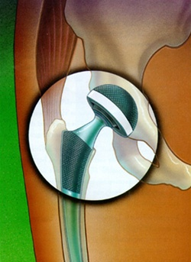
HIP REPLACEMENT

Slide 12
TOTAL HIP REPLACEMENT
“THE MOST EFFECTIVE SURGICAL PROCEDURE OF THE 21ST CENTURY”

Slide 13
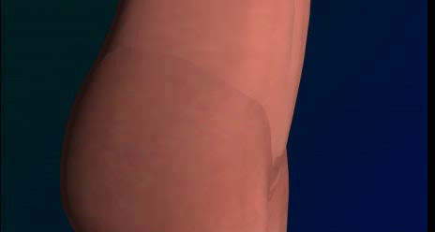
ANTERIOR HIP REPLACEMENT

Slide 14
HOW CAN I GET THROUGH THIS SURGERY WITH LESS PAIN AND A FASTER RECOVERY???
MINIMAL INVASIVE ANTERIOR HIP REPLACEMENT SURGERY
MULTIMODAL PAIN CONTROL
MODERN ANESTHESIA TECHNIQUES

Slide 15
MIS HIP SURGERY
ANTERIOR HIP
SMALL INCISION IN FRONT OF HIP
NO CUTTING OF MUSCLE OR TENDONS
IMPLANT POSITIONED BY DIRECT VISION OR XRAY
LITTLE POST OP RESTICTIONS
RETURN TO WORK IN 2-4WEEKS

Slide 16
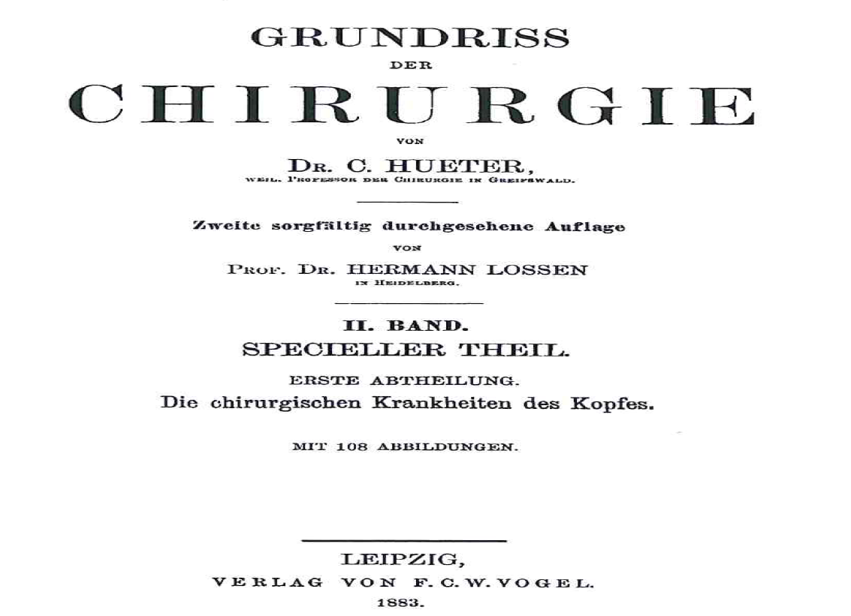
Direct Anterior Approach THR History
First described by Carl Hueter in Germany in ~ 1881
Hueter, C. Fünfte abtheilung: die verletzung und krankheiten des hüftgelenkes , neunundzwanzigstes capitel.
In: Hueter C, editor. Grundriss der chirurgie. 2nd edition. Leipzig; FCW Vogel; 1882. P 129-200.

Slide 17
ANTERIOR HIP
ADVANTAGES
  LEG LENGTHS
  STABILITY
  LESS MUSCLE DAMAGE

Slide 18
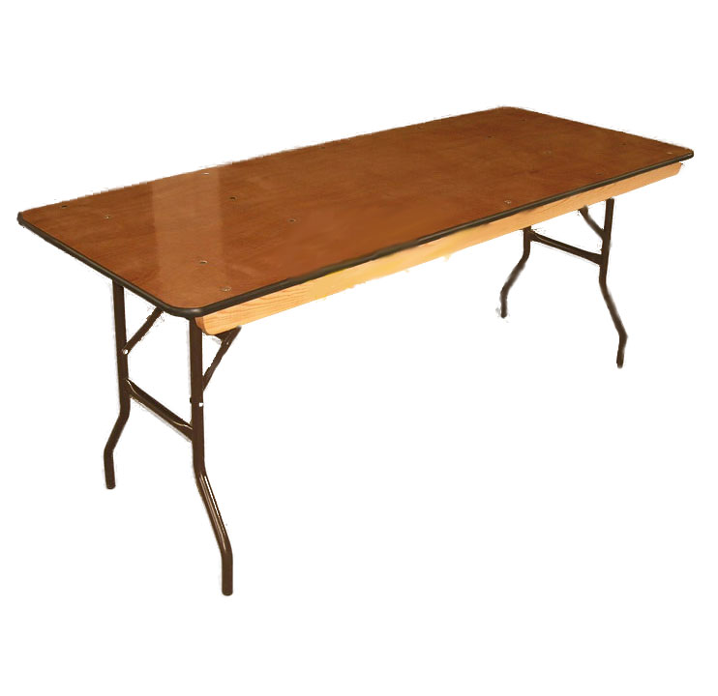
ANTERIOR HIP REPLACEMENT
-------THE TABLE--------

Slide 19
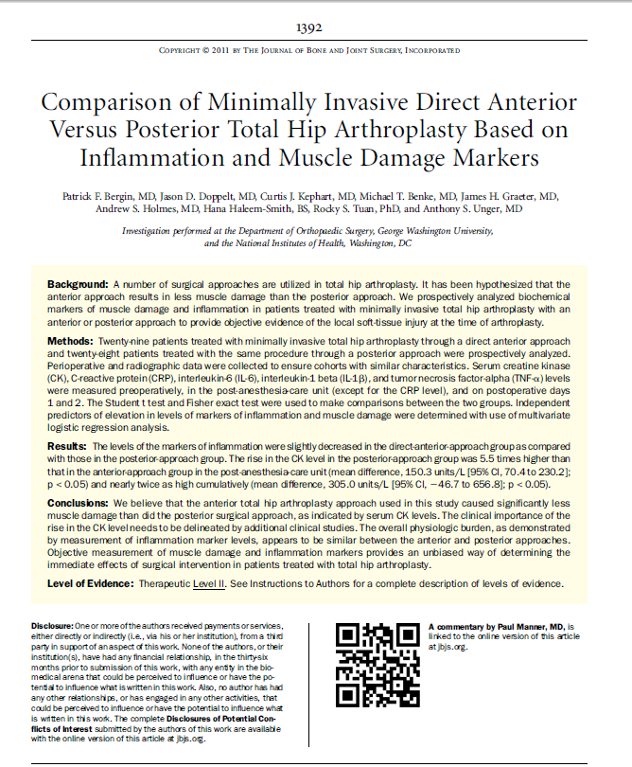

Slide 20
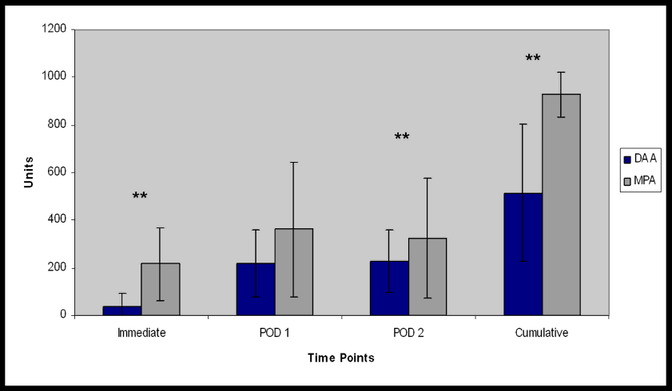
Creatine Kinase Differences between Anterior and Posterior MIS THA
5.5X
1.4X
1.8X

Slide 21
DAA-TABLE-LESS
BETTER FUNCTIONAL SCORES
  RESTREPO ET AL, J OF A, 2010
  PROSPECTIVE FUNCTIONAL OUTCOMES OF DAA VERSUS DIRECT LATERAL
  UP TO 2 YRS DAA HAD BETTER FUNCTION SCORES ON SHORT SF-36 AND WOMAC

Slide 22
ACTIVITIES AFTER SURGERY
WALKING/HIKING
SWIMMING
TENNIS
GOLF
AEROBICS
FITNESS
SKIING*
BIKING

Slide 23
HOW LONG WILL A TOTAL JOINT REPLACEMENT LAST?
25 + YRS IN MOST CIRCUMSTANCES

Slide 24
MULTIMODAL ANESTHESIA
ORAL MEDICINES GIVEN BEFORE SURGERY TO REDUCE PAIN AND SWELLING
LOCAL ANESTHEICS INJECTED INTO HIP/KNEE JOINT AT THE CONCLUSION OF SURGICAL PROCEDURE

Slide 25
PREOPERATIVE MEDICINES TO REDUCE PAIN AND SWELLING
COX-2 INHIBITORS(CELEBREX)
GABAPENTIN
TYLENOL
MAGNISIUM
IV STEROIDS

Slide 26
LOCAL ANESTHEITIC INJECTIONS INTO KNEE/HIP
RAPIVACAINE-LONG ACTING LOCAL ANESTHETIC
MORPHINE- REDUCE PAIN
EPINEPHRINE
TORADOL

Slide 27
WITH MULTIMODAL THERAPY, MODERN ANESTHESIA AND MIS SURGICAL TECHNIQUES MOST PATIENTS NEED ONLY A COUPLE OF DOSES OF IM NARCOTICS; THEREAFTER MOST PATIENTS DO VERY WELL WITH ORAL AGENTS(PERCOCET OR VICODIN)

Slide 28
ANTERIOR HIP REPLACEMENT
FASTER RECOVERY
LESS PAIN
MORE STABILITY
LESS RESTRICTIONS
NO ADVERSE OUTCOMES

Slide 29
THANK YOU!!!

