Slide 1
THE DIRECT ANTERIOR HIP REPLACEMENT
ANTHONY S UNGER, MD

Slide 2
ANTHONY S UNGER, MD
DISCLOSURES
INNOMED—ROYALTIES
BIOMET– ROYALTIES,CONSULTANT
STRYKER—CONSULTANT, SPEAKER
MEDTRONIC—SPEAKER
CORMET—RESEARCH GRANT

Slide 3
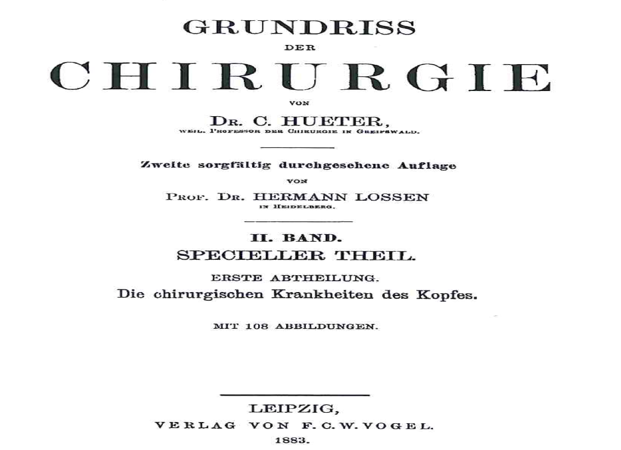
Direct Anterior Approach THR History
First described by Carl Hueter in Germany in ~ 1881
Hueter, C. Fünfte abtheilung: die verletzung und krankheiten des hüftgelenkes , neunundzwanzigstes capitel.
In: Hueter C, editor. Grundriss der chirurgie. 2nd edition. Leipzig; FCW Vogel; 1882. P 129-200.

Slide 4
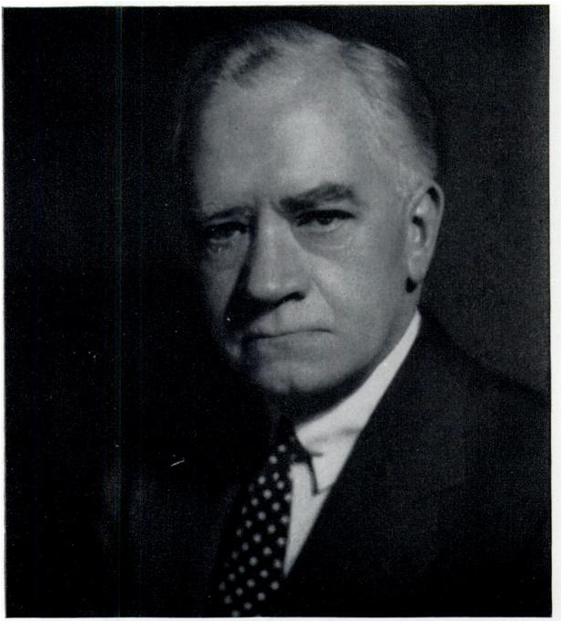
Direct Anterior Approach THR History
Use of the DAA in hip arthroplasty began with Smith Petersen
M. N. Smith Petersen
Smith Petersen, MN. A new supra-articular subperiosteal approach to the hip joint. JBJS Am 1917; s2-15: 592-5
Smith Petersen, MN. Approach to and exposure of the hip joint for mold arthroplasty. JBJS Am 1949; 31: 40-6

Slide 5
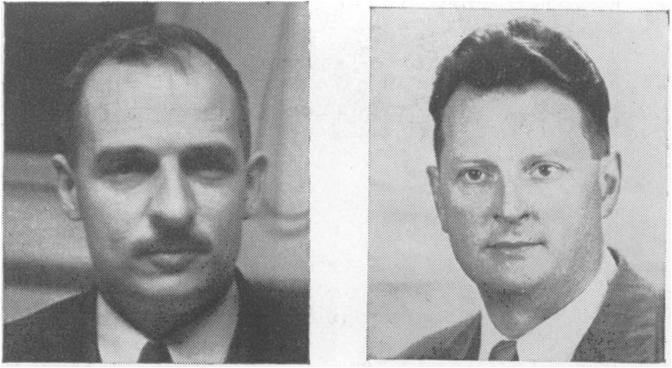
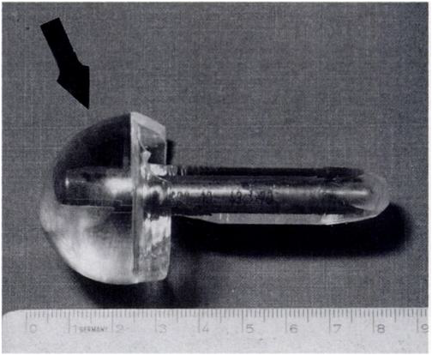
DAA continued on in limited use for THR with the Judets brothers in France
Direct Anterior Approach THR History
Dr. Robert Judet and Dr. Jean Judet.
Judet Acrylic Implant
Judet J, Judet R. The use of an artificial femoral head for arthroplasty of the hip joint. JBJS Br 1950; 32B: 166-73
Judet J, Judet H. Voie d’abord anterieure dans l’arthroplastie totale de la hanche. Presse Med 1985; 14: 1031-3

Slide 6
Direct Anterior Approach THR History
DAA continued on in limited use for THR with
Kristaps Keggi in the US.
Kristaps Keggi
Light TR, Keggi KJ. Anteior approach to hip arthoplasty. CORR 1980; 152: 255-60
Kennon RE, Keggi JM, Wetmore RS, et al. 2003. Total hip arthroplasty through a minimally invasive
anterior surgical approach. J Bone Joint Surg A 85:39–48.

Slide 7
Direct Anterior Approach THR History
specialized orthopedic table, popularized by Joel Matta.
Matta JM, Shahrdar C, Ferguson T. Single-incision anterior approach for total hip arthoplasty on an orthopaedic table.
CORR 2005; 441: 115-24
Stefan Kreuzer MD, Kevin Leffers BS, Suneel Kumar MD. Direct Anterior Approach for Hip Resurfacing:
Surgical Technique and Complications. CORR (2011) 469:1574–1581

Slide 8
Direct Anterior Approach THR History
The DAA in THR using a standard OR table.
Michael Nogler
Rachbauer F, NoglerM, Mayr E, et al. Minimally invasive single incision anterior approach for total hip arthoplasty-early results.
In: Hozack WJ, Krismer M, Nogler M, et al editiors. Minimally invasive total joint arthroplasty. Berlin: Springer; 2004. P. 54-9
Lovell T. Single incision direct anterior approach for total hip arthroplasty using a standard operating table. J arthroplasty;
Volume 23, Issue 7, Pages 64-68, October 2008

Slide 9
Direct Anterior Approach THR History
The principles and basic technique of the approach are the same with or without the use of a specialized orthopedic table.
The History of the anterior approach to the hip.
Rachbauer F, Kain MS, Leung M.
Orthop Clin North Am. 2009 Jul; 40(3): 311-20

Slide 10
Direct Anterior Approach Scientific Basis
Multiple Authors Have Proposed DAA THR Has:
Less Soft Tissue Damage
Faster & Easier Recovery
Lower Dislocation Risk
Is There Data For These Claims?
Anterior Approach in THA Improves Outcomes: Affirms. JOSEPH T. MOSKAL, Orthopedics, SEPTEMBER 2011 | Volume 34 • Number 9

Slide 11
DAA Has Less Soft Tissue Damage
More Abductor Damage With Posterior Approach
Than With Direct Anterior Approach
The posterior approach had measurable damage to the abductor muscles and gluteus minimus tendon in each specimen
Meneghini RM, Pagnano MW, Trousdale RT, Hozack WJ. Muscle damage during MIS total hip
arthroplasty: Smith-Petersen versus posterior approach. Clin Orthop Relat Res. 2006;453:293–8

Slide 12
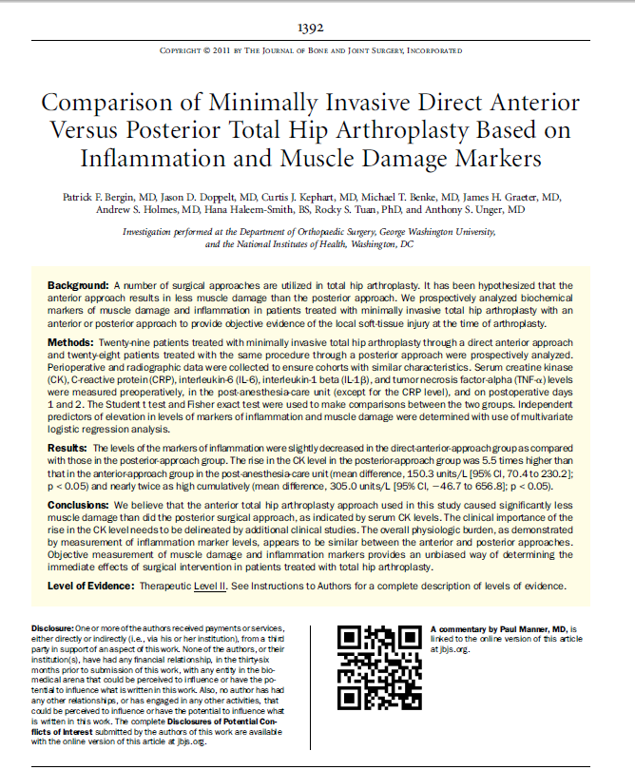

Slide 13
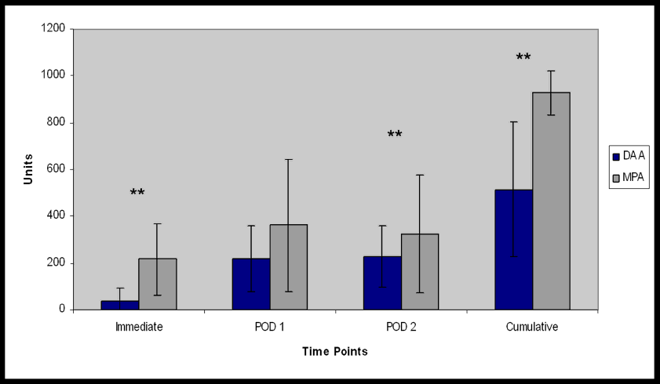
Creatine Kinase Differences between Anterior and Posterior MIS THA

Slide 14
Creatine Kinase Differences between Anterior and Posterior MIS THA
5.5X
1.4X
1.8X

Slide 15
Creatine Kinase Differences between Anterior and Posterior MIS THA

Slide 16
Creatine Kinase Differences between Anterior and Posterior MIS THA

Slide 17
DAA Recovery May Be Faster & Easier
A prospective, randomized study compared DL THA and DAA approach THA. Using numerous validated outcome measures the DAA THA had significantly better improvements at 6 weeks, 6 months, and 1 year than did the direct lateral approach THA.
Restrepo C, Parvizi J, Pour AE, Hozack WJ. Prospective randomized study of two surgical approaches for total hip arthroplasty J Arthroplasty. 2010; 25(5):671-679.e1.

Slide 18
DAA Recovery May Be Faster & Easier
A prospective, randomized IRB-approved clinical study comparing DAA to Posterior THA
CONCLUSION The DAA cohort required less post-op pain medication, half-day shorter hospitalization and patients had higher functional scores at one and three months.
Prospective Randomized Study of Anterior vs. Postero-lateral Approach for Total Hip Arthroplasty.
William P. Barrett, Shelly Turner. Session 44-Adult Reconstruction Hip VI, paper 655. AAOS 2012.

Slide 19
DAA Has A Lower Dislocation Rate
Appproach Number of THRs Dislocation Rate
Posterior 10187 4%
Transtrochanteric 1052 1.6%
Anterolateral 7473 2%
Sariali, E., P. Leonard, and P. Mamou J Arthroplasty, 2008. 23(2): p. 266–72.
dy, Dislocation after total hip arthroplasty using Hueter anterior approach.

Slide 20
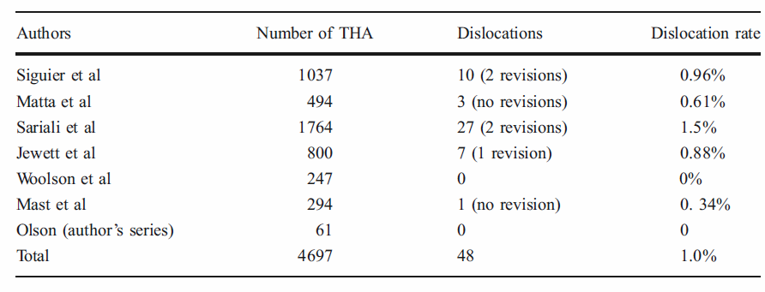
DAA Has A Lower Dislocation Rate
1% Dislocation Rate For DAA THR Using A Fracture Table
Direct anterior approach for total hip arthroplasty using the fracture table. Phillip H. Horne & Steven A. Olson. Curr Rev Musculoskelet Med (2011) 4:139–145

Slide 21
DAA ADVANTAGES
PATIENT SUPINE—LL EQUALIZATION
LOWER DISLOCATION RATE
LESS INVASIVE ?
OBESE PATIENTS EASIER
LESS DVT??—LESS KINKING OF FEMORAL VEIN

Slide 22
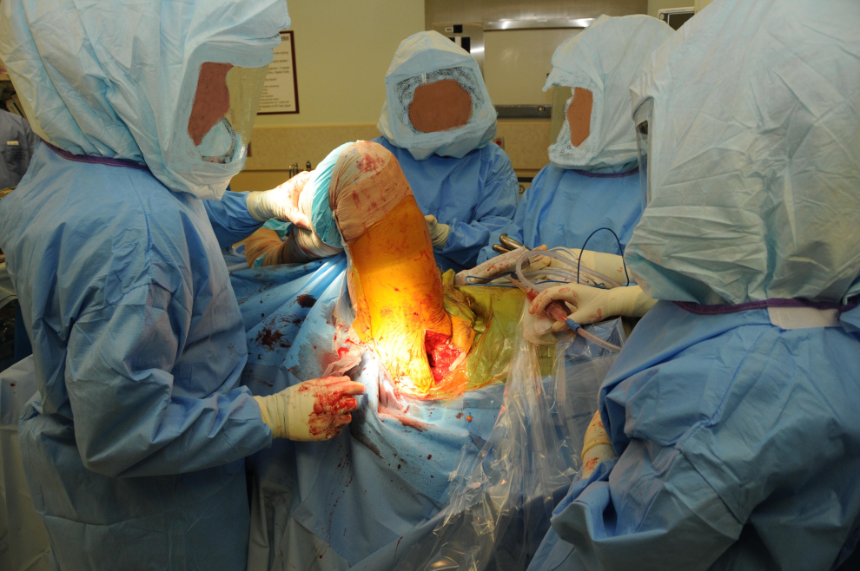
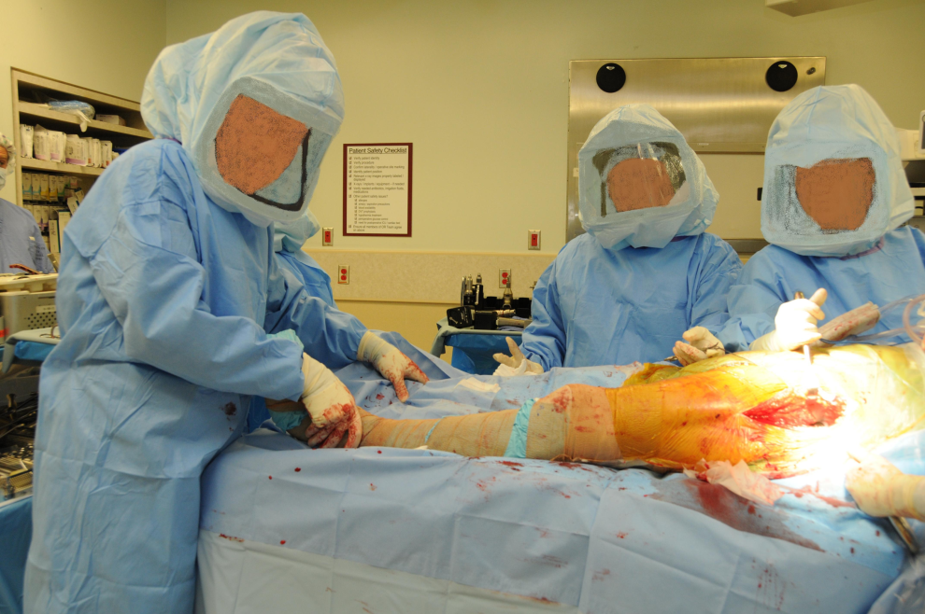
DAA-TABLE-LESS
ADVANTAGES
QUICKER, LESS SET UP
BETTER ASSESSMENT OF STABILITY
CHEAPER—NO TABLE COSTS
BETTER ABILITY TO EQUAL LL
DON’T NEED XRAY

Slide 23
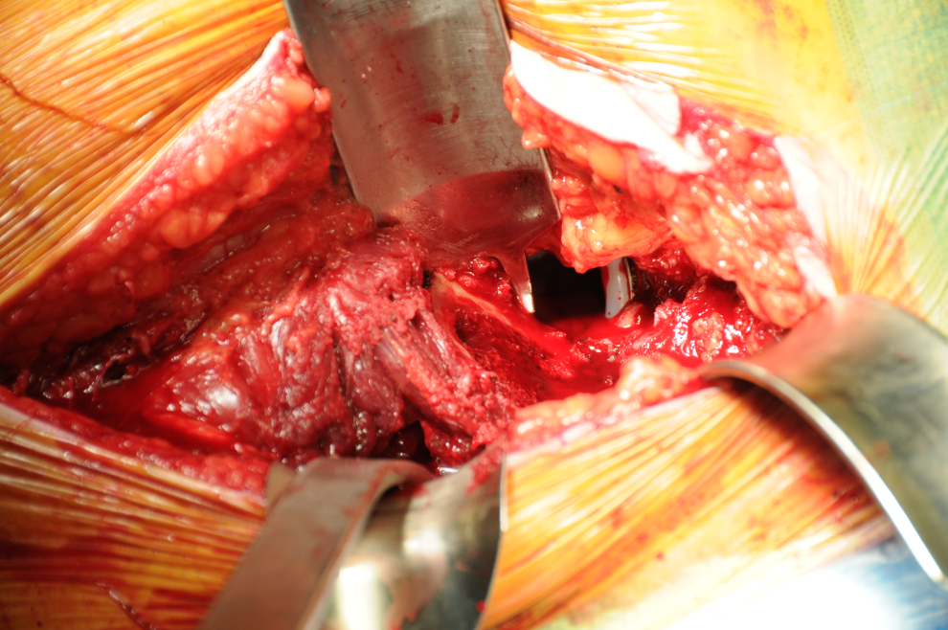
DAA-TABLE-LESS
DISADVANTAGES
NEED 2ND ASSISTANT
NO MARKETING OF TABLE
NEED GOOD SURGICAL EXPOSURE
NO XRAY TO ASSESS FEMORAL COMPONENT

Slide 24
MY SERIES
2005-2013
750 HIPS
DISLOCATIONS=4
LOOSE STEM=1
FRACTURE=1
INFECTION=1
AVG LOS =2 DAYS

Slide 25
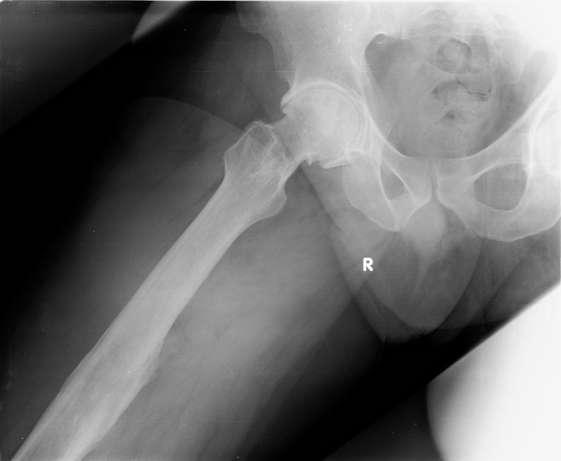
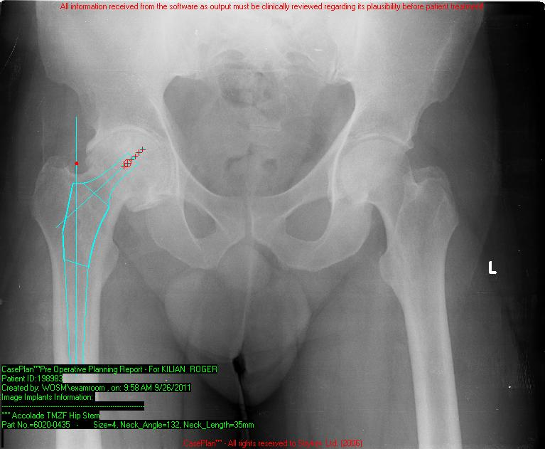
56 yo male, Hx of Femur FX, R Hip pain

Slide 26
RTHA DAA Intra op xray

Slide 27
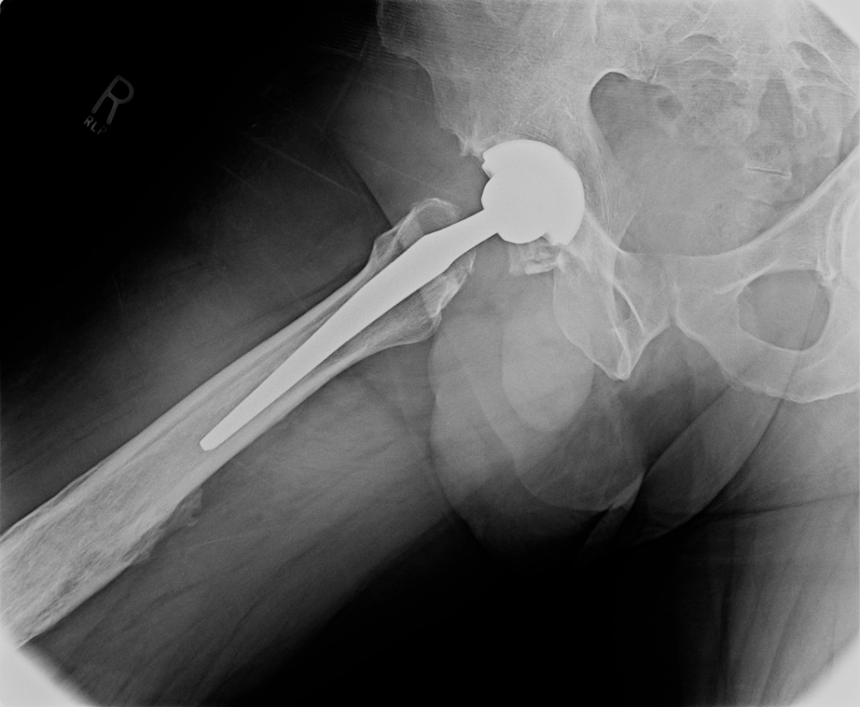
RTHA DAA Post op

Slide 28
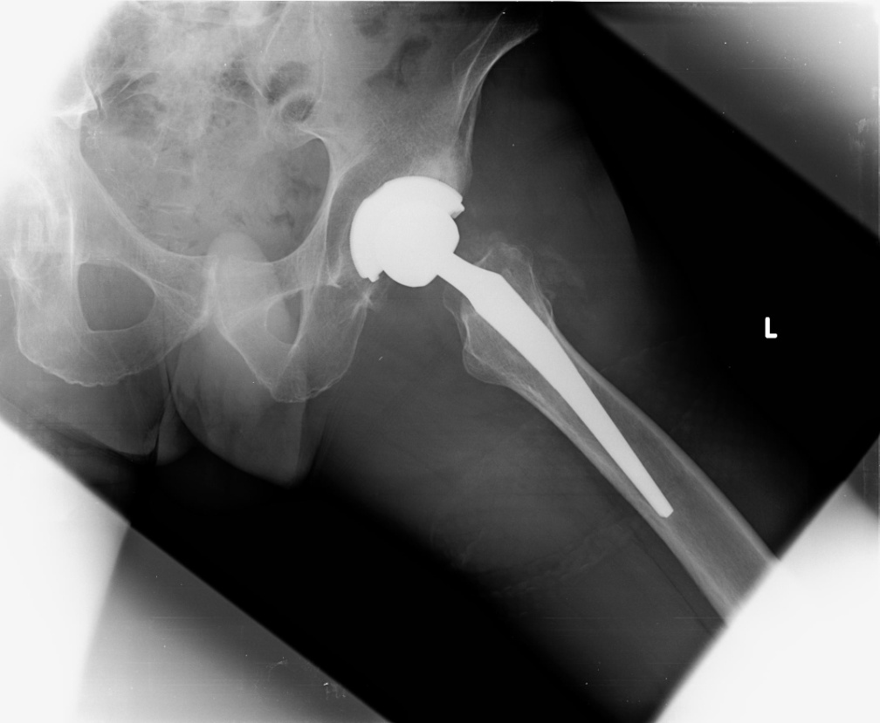
55 yo MD Bilat DJD HIP undergoes L-THA DAA

Slide 29
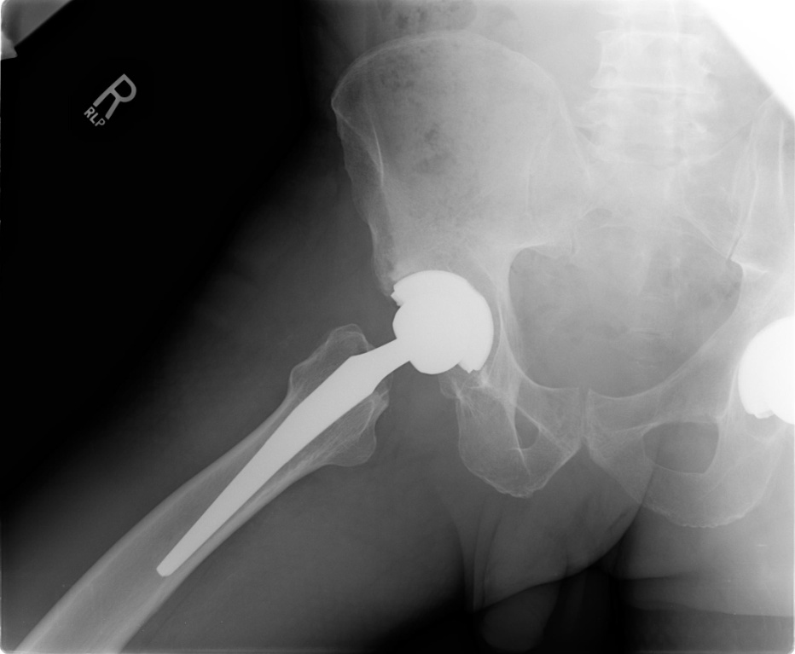
POST-OP R-THA after XRT

Slide 30
THANK YOU

