Slide 1
THE TRABECULAR METAL MONOBLOC ACETABULAR CUP DEMONSTRATES NO EARLY BEDDING-IN AND EXCELLENT CLINICAL PERFORMANCE AT 10-15 YEAR FOLLOW UP
ANTHONY S UNGER, MD
RANDALL J LEWIS, MD
JOHN MARTELL, MD

Slide 2
ANTHONY S UNGER, MD
DISCLOSURES
INNOMED—ROYALTIES
BIOMET– ROYALTIES,CONSULTANT
STRYKER—CONSULTANT, SPEAKER
CDD-STOCK HOLDER, ROYALTIES
J OF ARTHROPLASTY-EDITORIAL BOARD

Slide 3
Trabecular Metal Acetabular Cup
Used Clinically Since 1997

Slide 4
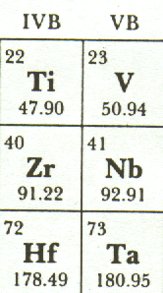
TANTALUM
A pure metallic element, # 73.
A strong, ductile metal similar to titanium.
Tantalum is the most biocompatible metal of all.
50+ years of clinical use; cranioplasty plates, radio opaque markers, pace maker leads, ligation clips, etc...

Slide 5
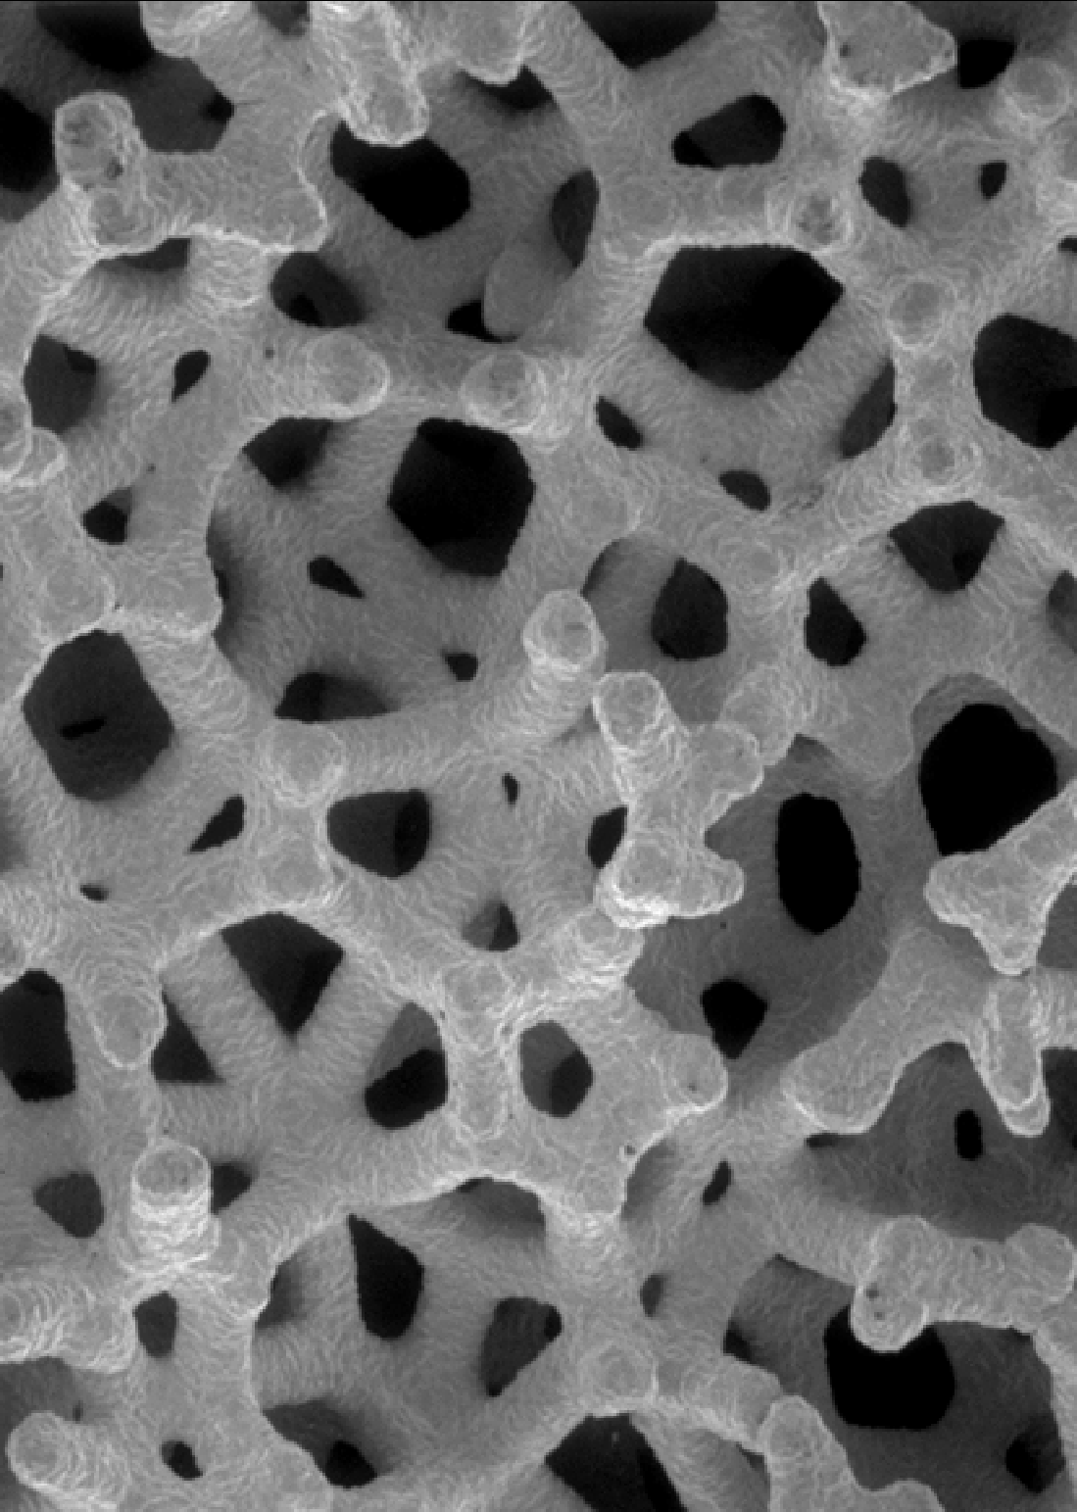
Properties
80 – 85% porosity
3-D open structure similar to bone
Uniform, repeating cellular structure
Consistent mechanical properties
Trabecular Metal

Slide 6
Properties
Large unrestricted pathways for tissue ingrowth
Stiffness similar to bone
‘Stand-alone’; no solid metal needed
Trabecular Metal

Slide 7
Stiffness of Orthopaedic Materials
205
200
Metals are 30 to 50X stiffer than bone & TM
180
160
Trabecular Metal
140
120
100
110
Stiffness (GPa)
Dense Cancellous Bone
80
60
40
15
20
0.8
1.0
1.5
2.0
3
0
Polyethylene
Bone Cement
Cortical Bone
Co-Cr Alloy
Cancellous Bone
Trabecular Metal
Titanium Alloy
Subchondral Bone

Slide 8
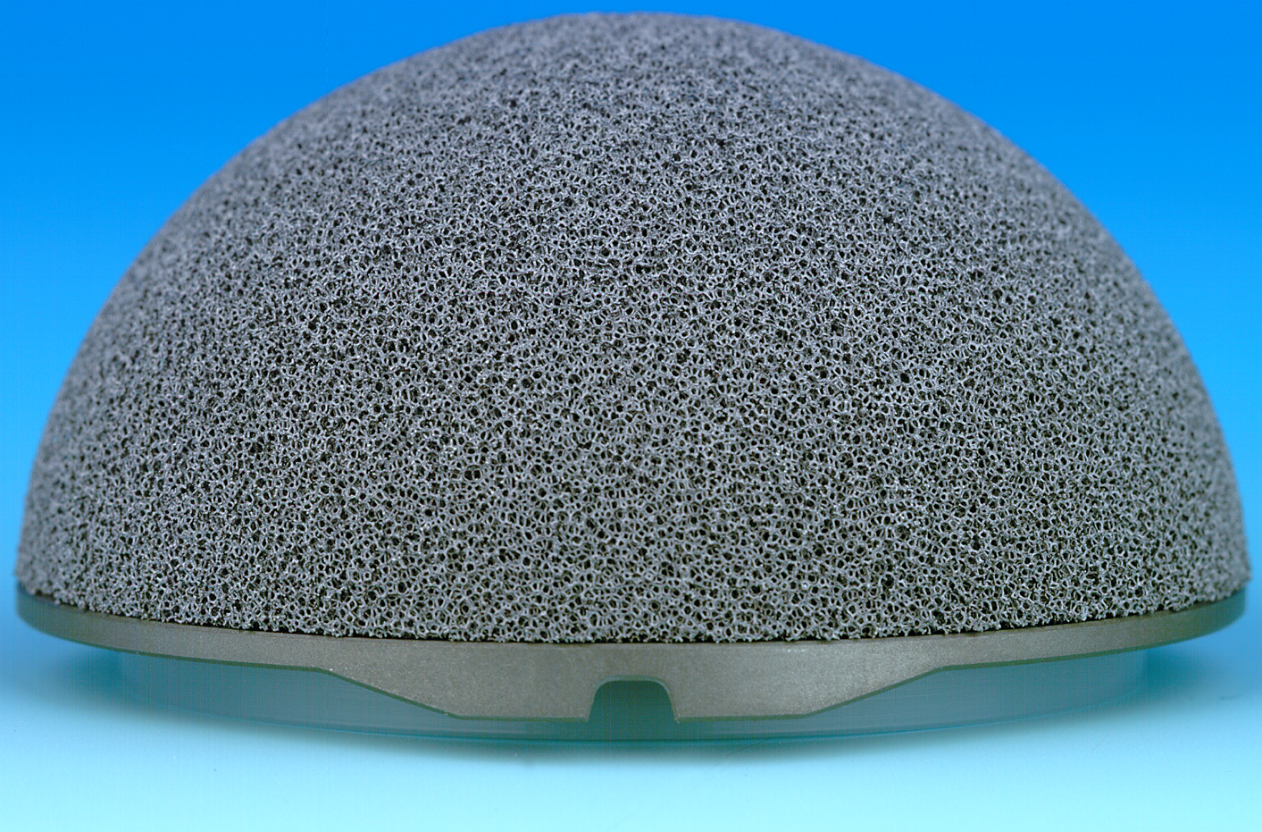
Cup Elliptical Profile
Cup Elliptical Profile
The Elliptical Profile
No bone displaced at dome
2 mm on the diameter
Spherical Preparation

Slide 9
DCM Poly – Low Wear
‘Problem Poly’ from literature
‘Gold Standard’
Poly from literature
Direct Molded Poly
Linear Wear mm/year

Slide 10
Direct Compression Molded Polyethylene
INTEGRATED
Into Trabecular Metal

Slide 11
Trabecular Metal
1.5 to 2.0 mm of poly penetration into Trabecular Metal
Direct Compression Molding of Poly Into the TMT Shell
Calcium stearate free UHMWPE resin…
The ‘Interface’
Polyethylene
…Is directly molded into the Trabecular Metal Shell

Slide 12
A Potential Source of Osteolysis
abrasion and screw holes with direct access to bone
Backside poly wear & metal debris from locking mechanism

Slide 13
CASE EXAMPLE
56 yr
Female
DJD
Rochester, MN
Pre-Op

Slide 14
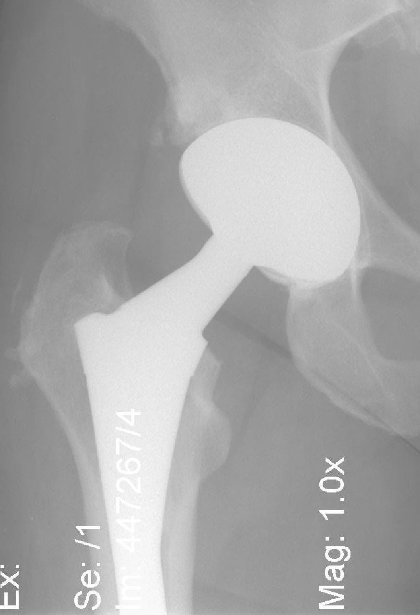
Patient is pain-free with excellent function & ROM
Rochester, MN
2 years

Slide 15
METHODS
347 PRIMARY THA IN 321 PTS
TWENTY BILATERAL THA
ALL SEEN AT MIN 10 YR FU
XRAYS AND CLINICAL EVALUATION AT 6 WKS, 6 MONTHS, YEARLY INTERVALS
HARRIS HIP SCORES

Slide 16
METHODS
ANALOG IMAGES CONVERTED BY VIDAR DIAGNOSTIC PRO
DIGITAL IMAGES ANALYZED IN DICOM FORMAT
WEAR RATE ANLYSIS BY EDGE DETECTION METHOD OF MARTELL

Slide 17
METHODS
BEDDING-IN DETERMINED BY WEAR RATE COMPARISON BETWEEN 6 WEEK TO ONE YEAR VERSUS ONE YEAR TO LONGEST FU
BEDDING-IN CONSIDERED NOT PRESENT WHEN NO SIGNIFICANT DIFFERENCE SEEN EARLY(ONE YEAR) WEAR AND LONGEST FU WEAR

Slide 18
RESULTS
FU RANGE 10-15.4 YRS, MEAN 12.4
347 HIPS PERFORMED FROM 1997-2003
101 EXCLUDED DUE TO DEATH
108 LOST TO FU, OR TOO OLD TO RETURN
132 HIPS AVAILABLE FOR ANALYSIS

Slide 19
RESULTS
HARRIS HIP SCORE 91 AT FU
NO CUP ASEPTIC LOOSENING
NO OSTEOLYSIS
NO REVISION FOR CUP LOOSENING
SIX HIPS REVISED FOR RECURRENT DISLOCATION

Slide 20
WEAR ANALYSIS
ANTEVERSION MADE SOME CUPS IMPOSSIBLE TO VISUALIZE THE HEAD
WEAR ANALYSIS FOR BEDDING-IN PERFORMED IN 67 HIPS
TRUE WEAR ANALYSIS IN 55 HIPS

Slide 21
WEAR ANALYSIS
 | BEDDING IN | TRUE WEAR | ONE WAY ANOVA | MANN-WHITNEY
#HIPS | 67 | 55
MEAN LINEAR WEAR RATE(MM/YR) | 0.096 | 0.133 | P=0.44
MEDIAN LINEAR WEAR RATE(MM/YR) | 0.099 | 0.099 |  | P=0.66
LINEAR STD DEV | .216 | 0.31
MEAN VOL RATE(MM3/YR) | 55.5 | 84.26 | P=0.27
MEDIAN VOL RATE(MM3/YR) | 22.1 | 18.01 |  | P=0.91
VOL STD DEV | 112 | 173

Slide 22
CONCLUSIONS
OVERALL WEAR RATE LOW
NO OSTEOLYSIS OR LOOSENING AT 15 YR FU
CLINICAL RESULTS EXCELLENT
BEDDING-IN DOES NOT OCCUR IN MONOBLOC DESIGNED CUP WITH DCM POLY

