Slide 1
PSOAS TENDONITIS IN DAA
ANTHONY S UNGER, MD
WASHINGTON, DC

Slide 2
ANTHONY S UNGER, MD
DISCLOSURES
INNOMED—ROYALTIES
ZIMMER/BIOMET– ROYALTIES,CONSULTANT
STRYKER—CONSULTANT, SPEAKER
SIGNATURE ORTHOPAEDICS-STOCK HOLDER, ROYALTIES
J OF ARTHROPLASTY-EDITORIAL BOARD
ARTHROPLASTY TODAY-EDITOR BOARD

Slide 3
IS ANTERIOR GROIN PAIN A PROBLEM AFTER DAA???
YES---BUT PREVENTABLE

Slide 4
PSOAS TENDONITIS=GROIN PAIN

Slide 5
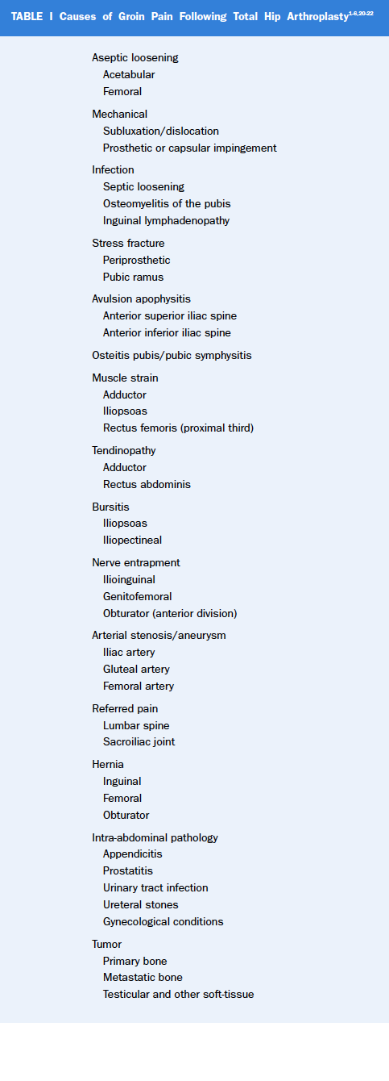

Slide 6
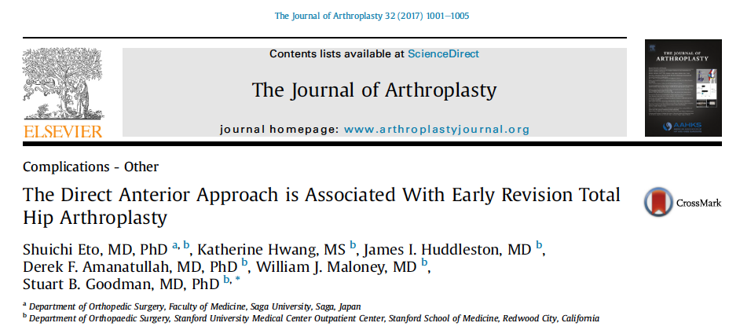

Slide 7
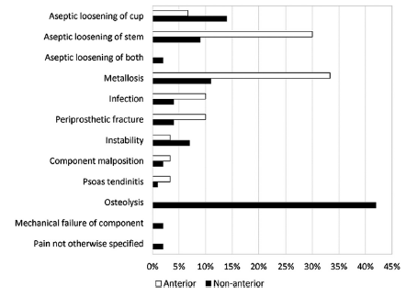

Slide 8
ANTERIOR OVERHANG>8 MM
Iliopsoas Impingement After Primary Total Hip Arthroplasty: Operative and Nonoperative Treatment Outcomes
Chalmers, Brian P.; Sculco, Peter K.; Sierra, Rafael J.; Trousdale, Robert T.; Berry, Daniel J.
JBJS. 99(7):557-564, April 5, 2017.
doi: 10.2106/JBJS.16.00244

Slide 9
HISTORY
ANTERIOR GROIN PAIN UPON RISE FROM CHAIR OR STAIR CLIMB
USUALLY AFTER 6 -12 WEEKS POST OP

Slide 10
PHYSICAL EXAM
PAINLESS PASSIVE ROM
PAIN ON SLR OR ACTIVE FLEXION
PAIN ON PALPATION OVER PSOAS TENDON

Slide 11
IMAGING
XRAY-AP AND X-TABLE LATERAL
MRI-MARS
ULTRASOUND GUIDED INJECTION

Slide 12
PREVENTION
HOLD PT UNTIL 6 WEEKS
NO OPEN CHAIN HIP FLEXION IN FIRST 6 WEEKS
WORK WITH KNOWLEDGABLE PT

Slide 13
PT for DAA is DIFFERENT !!

Slide 15
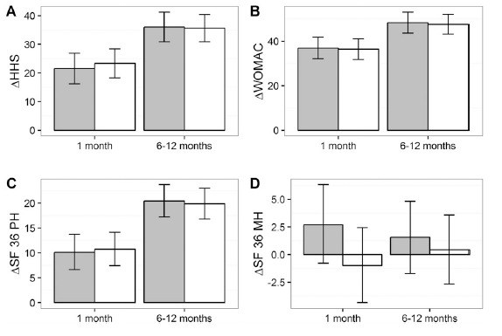

Slide 16
PREVENTION
NO ANTERIOR OVERHANG
BURY CUP
SAVE MEDIAL CAPSULE??

Slide 17
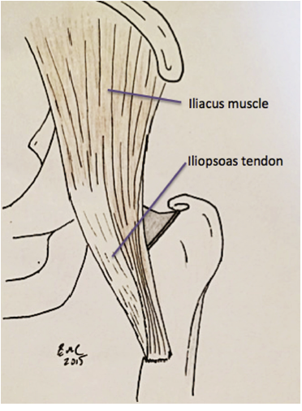

Slide 18
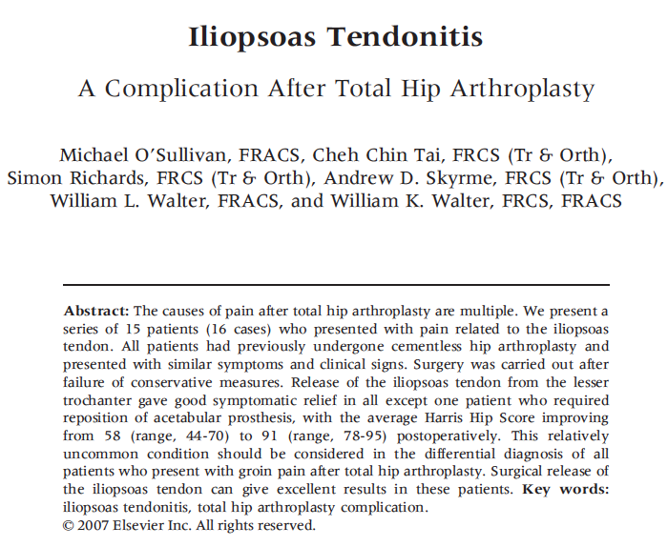

Slide 19
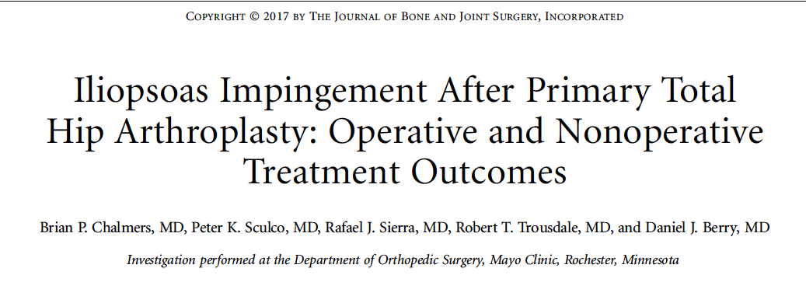

Slide 20
CUP OVERHANG>8 MM
Iliopsoas Impingement After Primary Total Hip Arthroplasty: Operative and Nonoperative Treatment Outcomes
Chalmers, Brian P.; Sculco, Peter K.; Sierra, Rafael J.; Trousdale, Robert T.; Berry, Daniel J.
JBJS. 99(7):557-564, April 5, 2017.
doi: 10.2106/JBJS.16.00244

Slide 21
ANTERIOR OVERHANG>8 MM
Iliopsoas Impingement After Primary Total Hip Arthroplasty: Operative and Nonoperative Treatment Outcomes
Chalmers, Brian P.; Sculco, Peter K.; Sierra, Rafael J.; Trousdale, Robert T.; Berry, Daniel J.
JBJS. 99(7):557-564, April 5, 2017.
doi: 10.2106/JBJS.16.00244

Slide 22
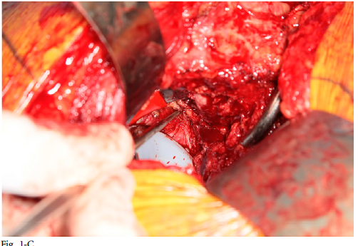

Slide 23
REVISE CUP
Iliopsoas Impingement After Primary Total Hip Arthroplasty: Operative and Nonoperative Treatment Outcomes
Chalmers, Brian P.; Sculco, Peter K.; Sierra, Rafael J.; Trousdale, Robert T.; Berry, Daniel J.
JBJS. 99(7):557-564, April 5, 2017.
doi: 10.2106/JBJS.16.00244

Slide 24
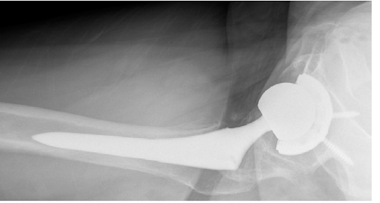

Slide 25
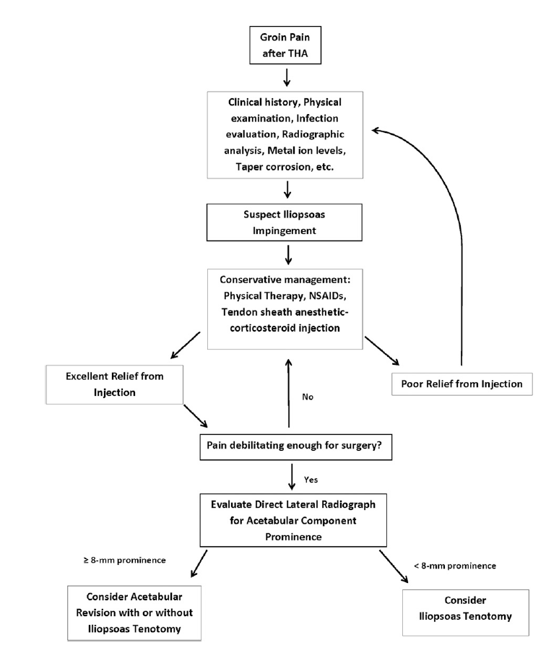

Slide 26
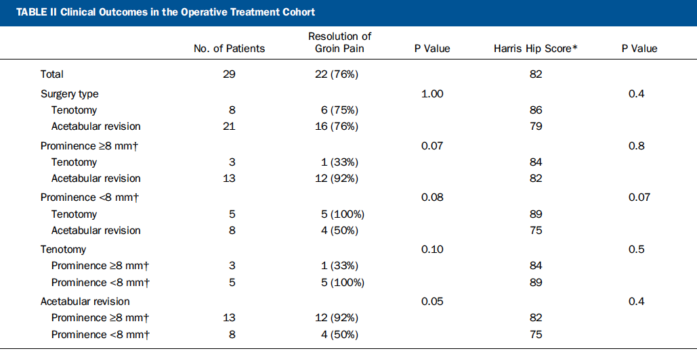

Slide 29
NON-OP RX
NSAI
PT
GUIDED INJECTION
STEROID
BOTOX
PRP??

Slide 30
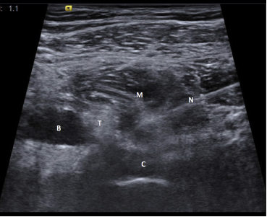

Slide 31
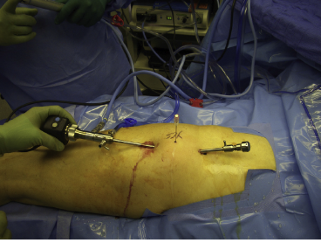
HIP SCOPE

Slide 32
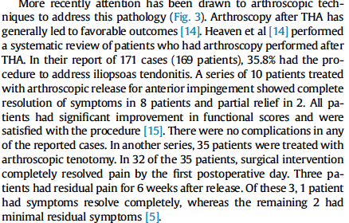

Slide 33
CONCLUSION
IN OR-- WATCH OUT FOR ANTERIOR IMPINGEMENT
HOLD THE PT
FOLLOW THE ALGORITHIM : RELEASE PSOAS for <8mm AND/OR REVISE CUP FOR >8mm in CHRONIC CASES

