Slide 1
TOTAL HIP REPLACEMENT IN THE ELDERLY
ANTHONY S UNGER, MD
WASHINGTON, DC

Slide 2
ANTHONY S UNGER, MD
DISCLOSURES
INNOMED—ROYALTIES
ZIMMER/BIOMET– ROYALTIES,CONSULTANT
STRYKER—CONSULTANT, SPEAKER
SIGNATURE ORTHOPAEDICS-STOCK HOLDER, ROYALTIES
J OF ARTHROPLASTY-EDITORIAL BOARD

Slide 3
THE ELDERLY----80 YRS AND ABOVE

Slide 5
Facts
1. What is the average life expectancy for someone born in U.S. in 1900? In 2015??
2. How old is the oldest living person ever recorded?

Slide 6
life expectancy(us) by birth year
1900------- 47
2015------- 79

Slide 7
Oldest Person Age=122

Slide 8
EXPANDING POPULATION OF ELDERLY PATEINTS
POPULATION OF >65 YO GROWING 15.1% VS 9.7%
>85 DOUBLES BY 2030
PERCENT OF POPULATION
2.5% BY 2030
4.5% BY 2050

Slide 9
GROWTH RATE OF THA INCREASING
NONAGENARIANS (90-99) 136/10000
CENTANARIANS(100) 63/10000
CURRENT RATE over-ALL 30/10000

Slide 10
RESULTS OF THA FAVORABLE
PAGNANO-MAYO EXPERIENCE
MEDICAL CO-MORBITIES COMMON
MOST STEMS CEMENTED
AT 4.2 YO HSS SCORES IMPROVED
9/65 HAD COMPLICATIONS
25% IN ICU

Slide 13
Risk Adjustment Is Necessary in Medicare Bundled Payment Models for Total Hip and Knee Arthroplasty
P. Maxwell Courtney, MD, Daniel D. Bohl, MD, MPH, Edmund C. Lau, MS, Kevin L. Ong, PhD, Joshua J. Jacobs, MD, Craig J. Della Valle, MD
The Journal of Arthroplasty
Volume 33, Issue 8, Pages 2368-2375 (August 2018)
DOI: 10.1016/j.arth.2018.02.095
Copyright © 2018 Elsevier Inc. Terms and Conditions

Slide 14
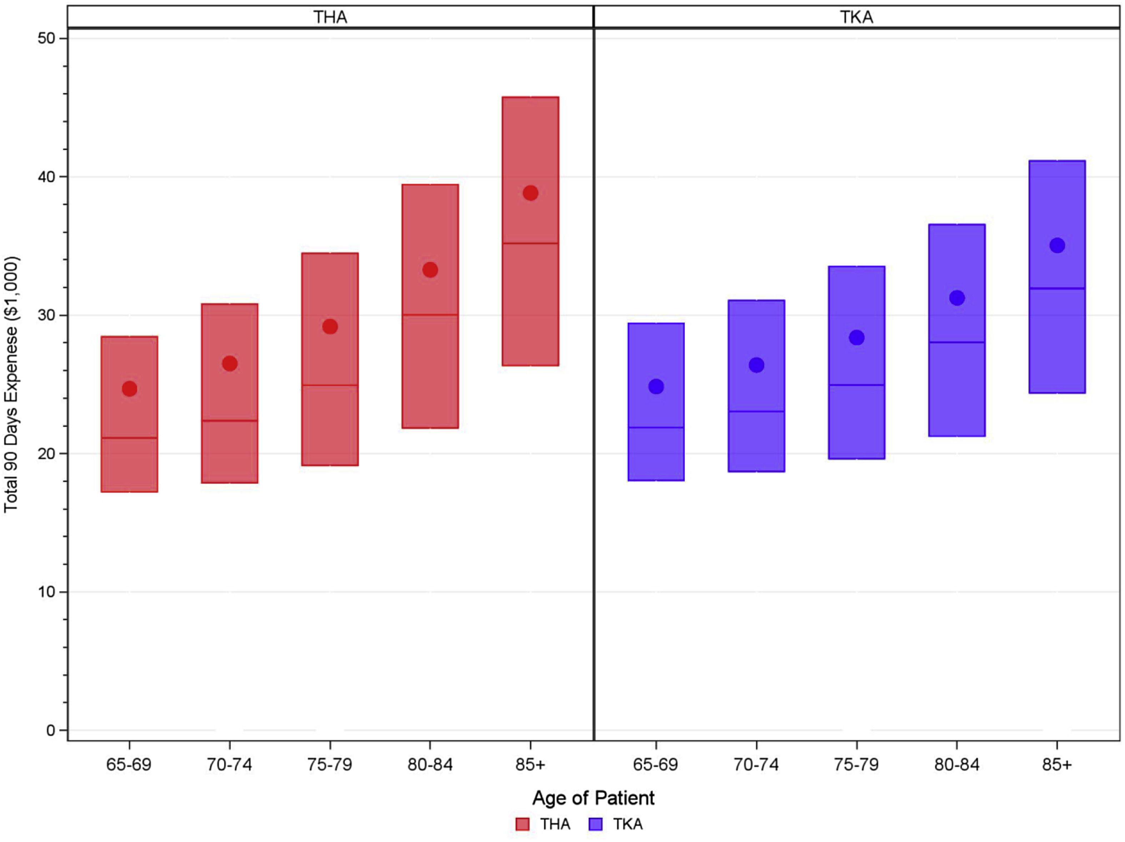
Fig. 2
The Journal of Arthroplasty 2018 33, 2368-2375DOI: (10.1016/j.arth.2018.02.095)
Copyright © 2018 Elsevier Inc. Terms and Conditions
Notes:
Comparison of mean 90-day episode-of-care Medicare costs by age among patients undergoing THA and TKA.

Slide 17
ISSUES WITH ELDERLY PATIENTS
PERIPROSTHETIC FRACTURES
MORTALITY/CO-MORBIDITES
EXTENDED STAY
DISLOCATION
COGNITIVE DYSFUNCTION

Slide 18
ELDERLY – THA FXS

Slide 19
PERIPROSTHETIC FRACTURES
RATE INTRAOP FROM 0.1- 27.8%
RATE POST OP FROM 0.07-18%
INCREASED RISK WITH OSTEOPOROSIS, RA, PRESS FIT FEMUR, PROXIMAL FEMORAL DEFORMITIES, PREVIOUS SURGERY, REV THA
SIDLER-MAIER ET AL. INT ORTHOP 2015

Slide 20
PERIPROSHETIC FRACTURES
SWEDISH REGISTRY
HIGHER MORTALITY
EST PROBABILITY OF DEATH 3.9% IN MEN, 2.2% IN WOMEN

Slide 21
PERIPROSHETIC FRACTURE
FINNISH REGISTRY
HIGHER REVISION AND FAILURE RATE WITH CEMENTLESS VS CEMENTED
MORTALITY HIGHER FOR CEMENTLESS BECAUSE OF FRACTURES
JAMSEN ET AL CORR, 2014

Slide 22
CEMENT OR CEMENTLESS
DATA SUPPORTS CEMENTED
LESS FXS WITH CEMENT
CEMENTLESS QUICKER AND SUCCESSFUL IN EXPERT HANDS

Slide 23
ELDERLY—FEMUR FXS
AUTHOR | YR | FX- NO CEMENT | FX CEMENTED | % | F/U
LANGLET | 2014 | 7.4% | 0.9% | 4.1% | 5
PARKER | 2011 | 1.5% | 0% | 0.7% | 3.7
TAYLOR | 2012 | 15% | 1.3% | 8.1% | 2
KHAN | 2002 | 2.5% | 0% | 1.2% | 2.8

Slide 24
ELDERLY -- FXS
DATA SUGGESTS THAT FIRST FX MAY NOT BE LAST
MORTALITY RATE IS HIGH
CEMENTED BETTER THAN CEMENTLESS

Slide 25
ELDERLY PERIPROSTHETIC FXS—”A NEVER ENDING STORY”

Slide 26
ELDERLY -- FXS - ANOTHER ONE!!

Slide 27
ELDERLY- FXS

Slide 28
ELDERLY--FXS
CEMENTLESS FXS 2.4% AT 3.7 YR
FXS OCCUR EARLY AND LATE
2/3 IN FIRST YR
ALMOST ALL VANCOVER B 1 0R 2
INITIAL FX FROM OSTEOPOROSIS
LATER FXS FROM BONE REMODELING??
KIM ETAL J OF ARTHROPLASTY 2015

Slide 29
ELDERLY—CEMENTLESS DATA
MANY REPORTS OF SUCCESS IN ELDERLY WITH UNCEMENTED STEMS
REPORTS FROM “EXPERT SURGEONS”
BEREND 2003
MEDLING 2005
KEISU 2001

Slide 30
CEMENT VERSUS CEMENTLESS

Slide 31
DAA CEMENT TECHNIQUE
USE CURVED CEMENT STEM
MAKE SURE OFFSET BROACH ARTICULATES
USE POSTERIOR APPROACH IN DIFFICULT PATIENT

Slide 32
ELDERLY—CEMENT VS CEMENTED
A LITTLE MORE DIFFICULT IN THE DAA
WITH CORRECT STEM AND EQUIPMENT-OFFSET BROACHES, CURVED STEM
CEMENT 50% OF MY STEMS IN ELDERLY

Slide 33
MORTALITY IN ELDERLY THA
DEATH | <80 | 80-90 | >90
INTRA-OP | 0% | .1% | 0%
WITH-IN 30 DAYS | .1% | .7% | .6%
WITH IN 1 YR | .8% | 3.2% | 5.5%

Slide 34
ELDERLY CO- MORBIDITIES
CO-MORBIDITY | <80 YO | 80-89 YO | >90 YO
HYPERTENSION | 52% | 72% | 77%
DIABETES | 21% | 23% | 19%
PERIPHERAL VASCULAR | 4% | 11% | 12%
CARDIAC | 3% | 9% | 12%

Slide 35
Cognitive Dysfunction
Beware!!!
Pt does not seem to get it in preop
Interview
Avoid at all costs!!

Slide 36
ELDERLY- COGNITIVE DYSFUNCTION
6.7 % INCIDENCE
68.3 % INCIDENCE OF ADVERSE EVENT IN THESE PATIENTS
SCREEN PEOPERATIVELY WITH MMSE—OR JUST TALK TO THEM
POSTLER ET AL. ARCH GERON GERI 2011

Slide 37
ELDERLY THA- EXTENDED STAY

Slide 38
Elderly-extended stay
LOS LONGER, NO SAME DAY SURGERY
MORE WORK FOR YOU AND YOUR TEAM
MOST NEED TO GO TO REHAB
PREPARE PT AND FAMILY FOR EXTENDED LOS AND EXTENED RECOVERY

Slide 39
ELDERLY-EXTENDED STAY
MEAN TIME TO RECOVERY OF INDEPENDENT WALKING WAS 12 DAYS
MEAN LOS WAS 7.5 DAYS(INCLUDING REHAB)
HAMEL ET AL. ARCHINT MED 2008

Slide 40
ELDERLY-THA DISLOCATION

Slide 41
ELDERLY –THA DISLOCATIONS
HIGHER IN ELDERLY
REDUCE WITH DAA
CONSIDER USING LARGE HEAD
CONSIDER MDM

Slide 42
ELDERLY--DISLOCATION
INCREASED RISK
RELATED TO COGNITIVE DYSFUNCTION
INCIDENCE IS 4% WITH POSTERIOR APPROACH
DAA MAY HELP
WOOLSON ET AL J OF ARHROPLASTY 1998

Slide 43
ELDERLY--INFECTION
40000 MEDICARE PTS
ELEVATED RISK IN RA,OBESITY,COAGULOPATHY, ANEMIA,
NO ADDED RISK WITH ELDERLY
BOZIC ET AL 2014

Slide 44
ELDERLY- HIP FXS

Slide 45
TOTAL HIP OR BIPOLAR
4 YR FU RANDOMIZED CONTROLLED
HARRIS HIP SCORE BETTER FOR THA
EQ-5D HEALTH SCORE BETTER FOR THA
BETTER RESULTS FOR THA IN LUCID ELDERLY PATIENTS WITH THA
HEDBECK ET AL JBJS 2011

Slide 46
ELDERLY—HIP FRACTURES
DAA HAS ADVANTAGES FOR THA OR BIPOLAR
BOTH DONE THROUGH HEUTER APPROACH
LESS DISLOCATION
MAY LEAD TO ACCELERATED REHAB EARLY DC
YAN ET AL. CURRENT ORTHO PRACTICE 2015

Slide 47
COORDINATED CARE
FAMILY
MEDICAL TEAM
NURSING
PT
SOCIAL WORK

Slide 48
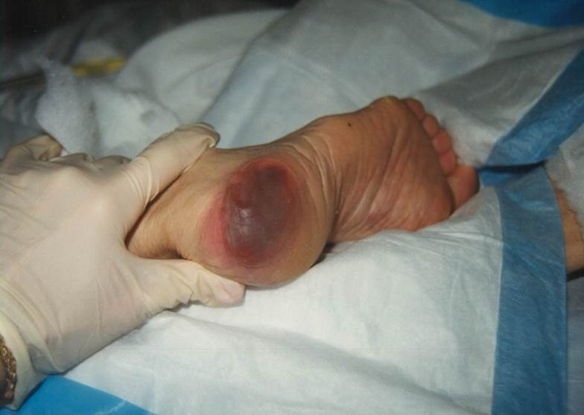
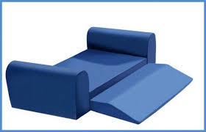
Notes:
.

Slide 49
ELDERLY THA-CLOSING COMMENTS
DELUGE OF PTS COMING
“GRAYING OF AMERICA’
MOST GRATEFUL PTS

Slide 50
BE PREPARED!!!

Slide 51
ELDERLY-CONCLUSIONS
EFFECTIVE PROCEDURE
HIGHER COMPICATIONS: DISLOCATION, LOS, FRACTURES, COGNITIVE DYSFUNCTION, MORTALITY
CAREFULLY SCREEN PREOP FOR COGNITIVE DYSFUNCTION
CEMENTED STEMS SHOULD BE CONSIDERED IN DORR C BONE, REDUCE FX RATE

Slide 52
THA IN ELDERLY
THANK YOU!!

