Slide 1
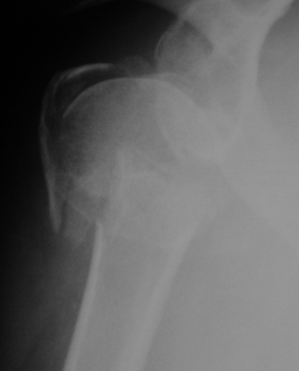
Current Concepts in Treatment of Proximal Humerus Fractures
J.R. Rudzki, MD, MSc
Washington Orthopaedics & Sports Medicine
Clinical Assistant Professor
Dept. of Orthopaedic Surgery
George Washington University School of Medicine
Washington, DC
Galway University Hospitals
Galway, Ireland
May 24, 2013

Slide 2
Disclosure
Arthrex – Consultant
AJSM, JBJS – Reviewer
AAOS – Evaluation Committee, BOC
Previous direct & indirect funding & support for research & education from:
Philips Medical Imaging
Bristol-Myers-Squib
Smith & Nephew
NIH (CT Chen)
HSS Institute for Sports Medicine Research
Major League Baseball

Slide 4
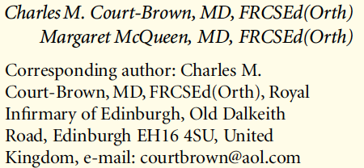
JBJS, 2009
The literature is deficient in helping us to consider which fractures will do better with surgical treatment.
This is important as proximal humeral fractures are common & getting more common as prevalence of osteoporotic fxs increases.
It is important that shoulder surgeons
and trauma surgeons start doing more
than simply assessing yet another plate.

Slide 5
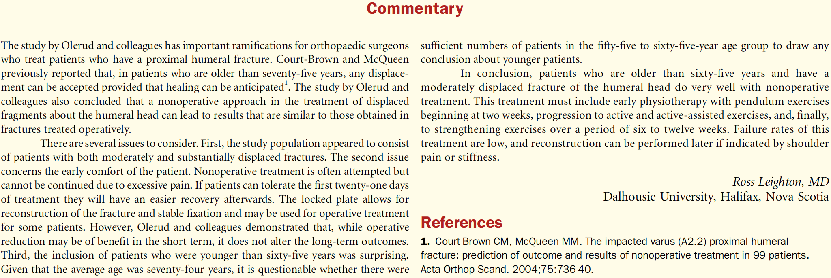
JSES, 2011
Prospective randomized trial of 59 pts mean age 74 yrs; mean F/U = 24 mos
13% of pts had a complication requiring a major reoperation
17% had a minor reoperation
Conclusion:
Advantage in functional outcome & HRQoL in favor of locking plate vs.
nonop tx in elderly pts with displaced 3-part fxs, but at cost of additional
surgery in 30% of pts.
NO SIGNIFICANT DIFFERENCE FOR:
DASH, Constant, Pain Scores

Slide 6
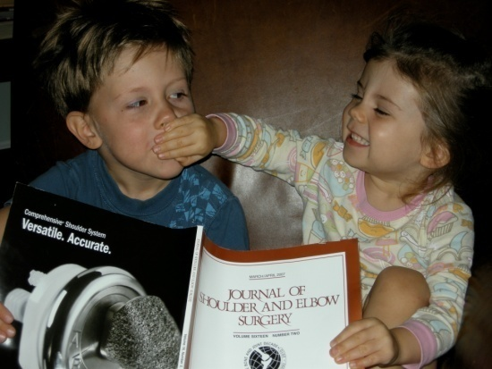
What is optimal management for displaced Proximal Humerus Fractures?
Controversial
Notes:
Growing body of evidence to support surgical intervention in pts at high risk of recurrent instability

Slide 7
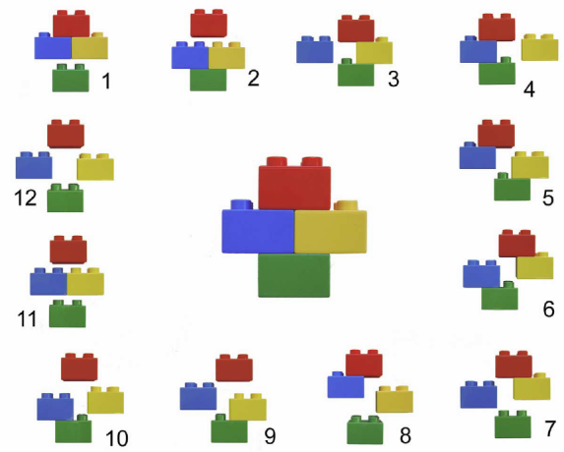
Fracture Classification
Radiographic Evaluation
Neer Classification
JBJS, 1970
Difficult – poor inter- & intra- observer reliability
Sidor et al., JBJS 1993
Siebenrock & Gerber et al., JBJS 1993
Sallay et al, JSES 1997
Hertel Classification
JSES, 2004
100 Proximal Humerus Fxs
Laser Doppler to assess ischemia
Medial Metaphyseal Head Extension
Medial Hinge Integrity

Slide 8
Hertel Classification
JSES, 2004
Fracture Patterns:
6 Possible Two-Part Fxs
5 Possible Three-Part Fxs
1 Possible Four-Part Fx
Not all 3-Part Fxs are the same
Longer hinge, lower likelihood of ischemia
Medial hinge integrity
Accuracy 0.84 for segments < 8 mm
Accuracy 0.79 for disrupted hinge
Poor Predictors of Ischemia in this Study:
Four-Part Fx - accuracy, 0.67
> 45° angular displacement - accuracy, 0.62
> 10 mm tuberosity displacement - accuracy, 0.61
Glenohumeral dislocation - accuracy, 0.49
Head-split - accuracy, 0.49
Three-Part Fx - accuracy, 0.38
Medial Metaphyseal Head Extension
Medial Hinge Integrity

Slide 9
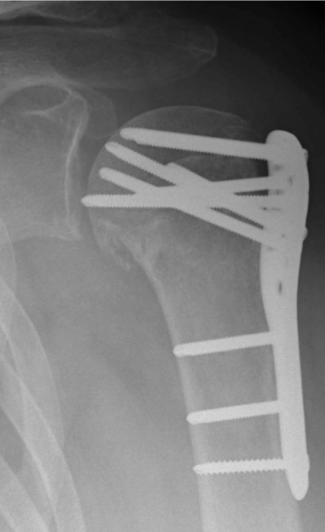
Introduction
JBJS, February - 2008: 53 Fractures
36% - Radiographic Signs of Complications
>10 degrees Varus Displacement = 25%
Screw Cut-Out & Intra-Articular Displacement = 23%
Occurred in 43% of pts > 60 y.o.
Revision Surgery required in 13%
98 % Healed; 4% Rate of Osteonecrosis
Associated with unexpectedly high rate of screw cutout & revision surgery, especially in pts > 60 yrs w/ 3- & 4-part fxs.
Indications for ORIF in these pts require continued analysis

Slide 10
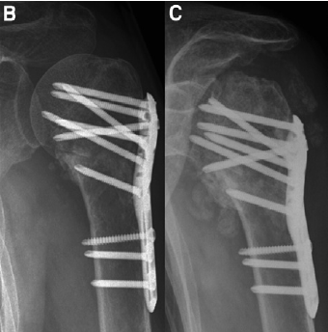
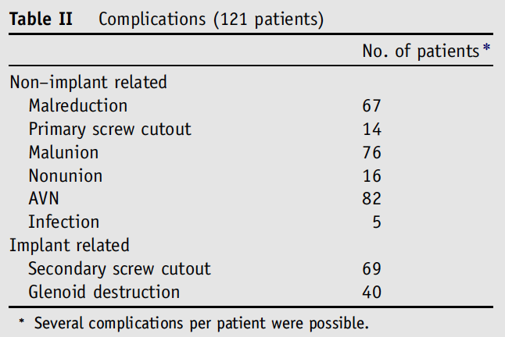
JSES, 2013
Level IV Retrospective Analysis: 121 pts with Complications after ORIF
Secondary screw cutout was found in 57%
- Glenoid Destruction in 33%

Slide 11
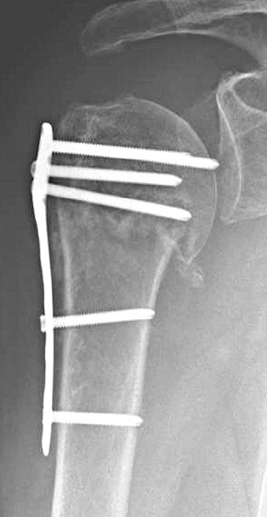
Fixation Failure
Typically occurs due
to varus collapse
Koukakis A, et al. Fixation of proximal humerus fractures using the PHILOS plate: early experience. CORR 2006 442:115-20
Egol KA, Ong CC, Walsh M, et al. Early complications in proximal humerus fractures (OTA Types 11) treated with locked plates.
J Orthop Trauma 2008;22:159-64
Brunner F, Sommer C, Bahrs C, et al. Open reduction and internal fixation of proximal humerus fractures using a proximal humeral locked plate: a prospective multicenter analysis.
J Orthop Trauma 2009;23:163
Lee CW, Shin SJ. Prognostic factors for unstable proximal humeral fractures treated with locking-plate fixation.
J Shoulder Elbow Surg 2009;18:83–88
Several Causes

Slide 12
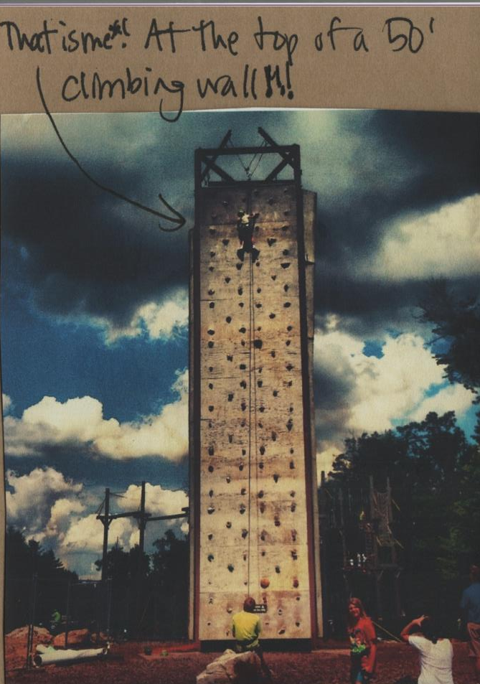
Valgus-Impacted 4-Part Fracture
3.5 month F/U

Slide 13
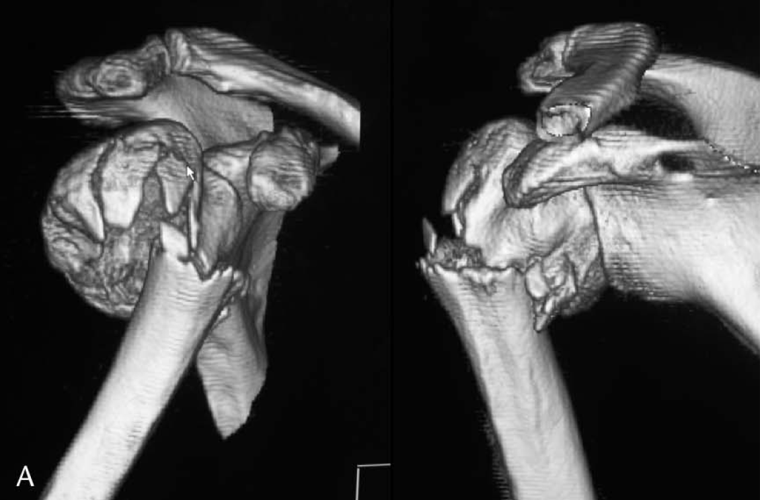
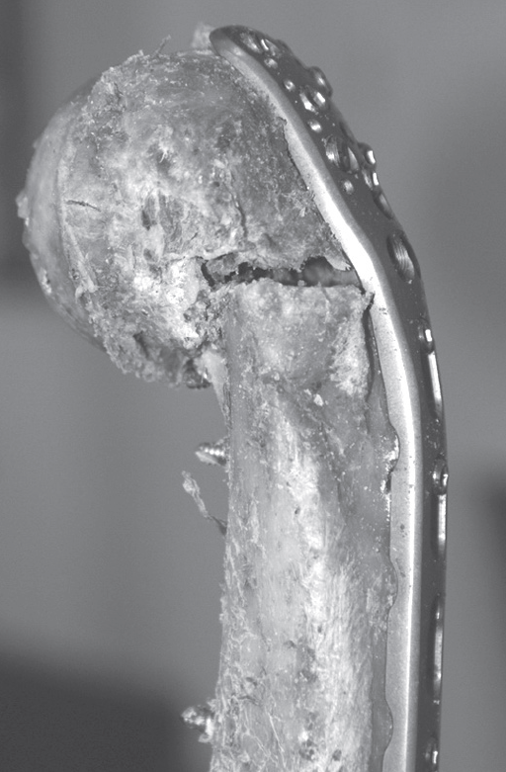
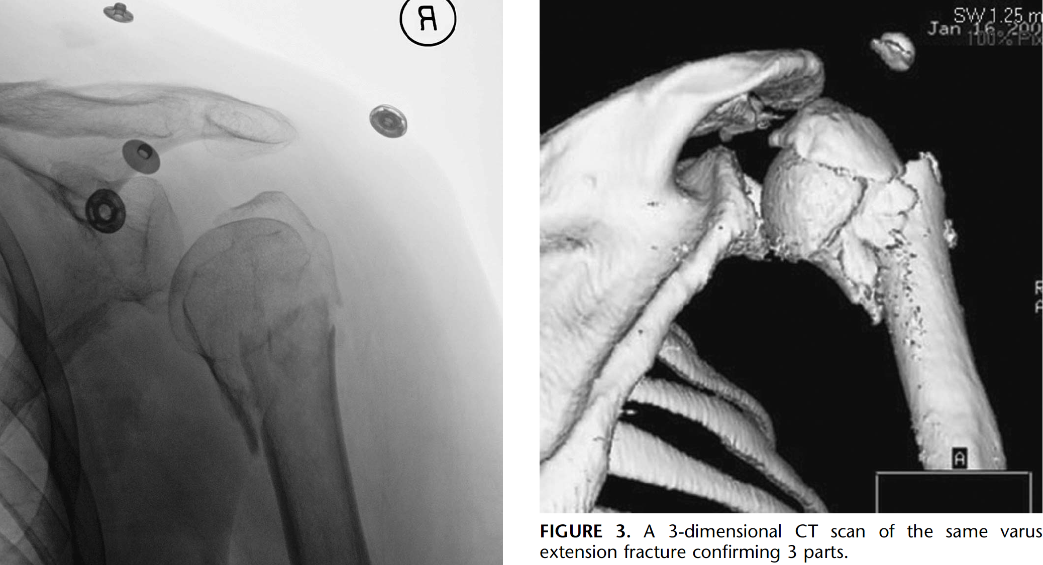
Varus-Extension Injury Pattern
Much More
Difficult Problem

Slide 14
JOT, 2009
Retrospective study 46 pts
Mean age of ~ 66 yrs & min. f/u of 18 mos
Five pts (7%) were taken back to O.R. w/in 48 hrs
for humeral head screw perforation >3 mm
Overall complication rate for varus group was 19/24 (79%)
vs 9/46 (19%) in valgus group (P < 0.01)
Complications in Varus Group:
screw perforation of humeral head in 5 (21%)
initial varus malreduction of >5 degrees in 17 (71%)
loss of fixation in 3 (13%)
Complications in the Valgus Group:
screw perforation of humeral head in 3 (7%)
initial varus malreduction >5 degrees in 8 (17%)
loss of fixation in 3 patients (7%)

Slide 15
JOT, 2009
6 pts w/ loss of fixation - initial varus malreduction > 20°
mean CS for this group at latest f/u was only 47 (r: 43–49)
despite conversion to secondary hemiarthroplasty
Secondary surgical procedures > 6 months after index
procedure in 29 pts:
Implant removal for mechanical subacromial impingement in 15 pts
(63%) in varus group versus 7 pts (15%) in valgus group (P = 0.02)
All 12 pts w/ AVN had metaphyseal segment length of < 2 mm
58 patients with metaphyseal segment > 2 mm or more did not develop AVN and this was independent of the presence or absence of initial dislocation (P < 0.001).

Slide 16
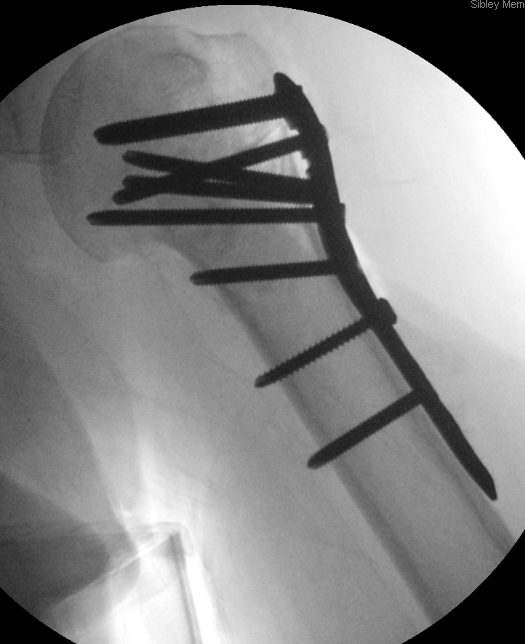
Where is the most important screw?

Slide 17
JOT, 2007
35 pts s/p ORIF followed to union
Medial support considered present if:
medial cortex anatomically reduced
proximal fragment impacted laterally in distal shaft
or oblique locking screw positioned inferomedially in humeral head
Medial support had significant effect on magnitude of subsequent reduction loss (P < 0.001)
Age, sex, fracture type, or cement augmentation had no effect on maintenance of redxn
Loss of reduction
Lack of medial support correlates with:
Of the 17 pts without medial support, loss of humeral height averaged 5.8 mm (P,0.001).
5 cases w/ screw penetration (P = 0.02), 2 of which required reoperation for removal.
Screw penetration
Notes:
All fractures in both groups healed without delay, and none required revision to arthroplasty.
Conclusions: Achieving mechanical support of the inferomedial region of the proximal humerus seems to be important for maintaining fracture reduction.
Locked plates are unable to support the humeral head alone from a lateral tension-band position.
Achieving an anatomic or slightly impacted stable reduction, as well as meticulously placing a superiorly directed oblique locked screw in the inferomedial region of the proximal fragment, may achieve more stable medial column support & allow for better maintenance of reduction

Slide 18
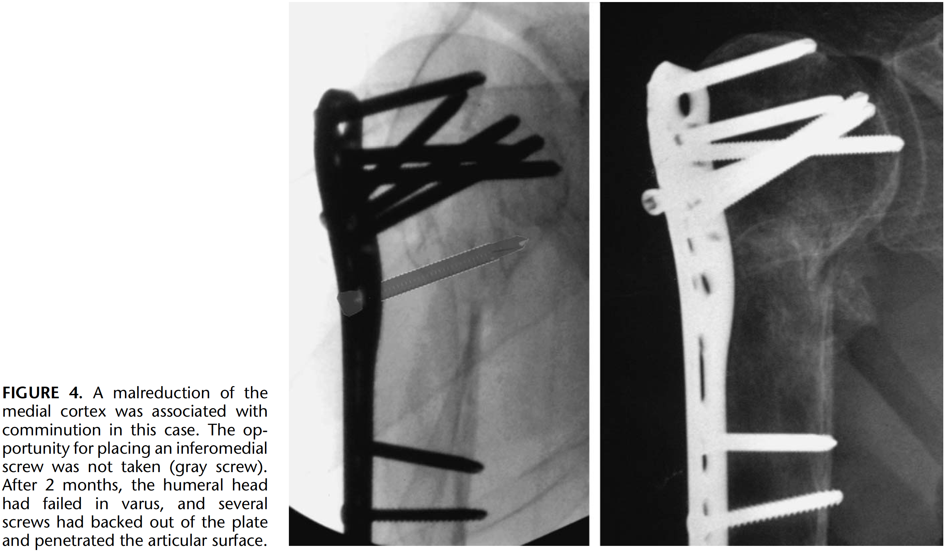
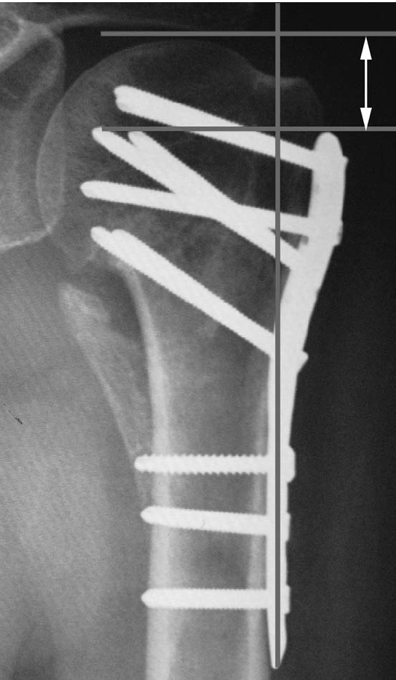
JOT, 2007

Slide 19
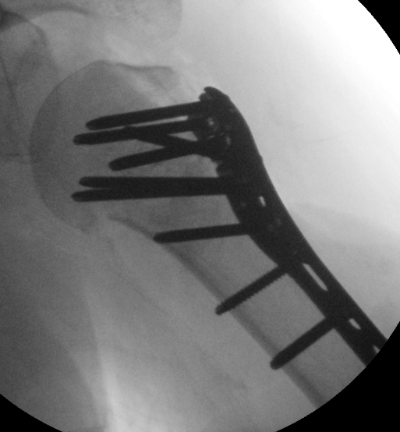
Varus-Extension 3-Part Fracture
Limited Options / Tough Choices:
Impaction
Inferomedial
Head Support
• Screw Placement
• Strut Graft?

Slide 20
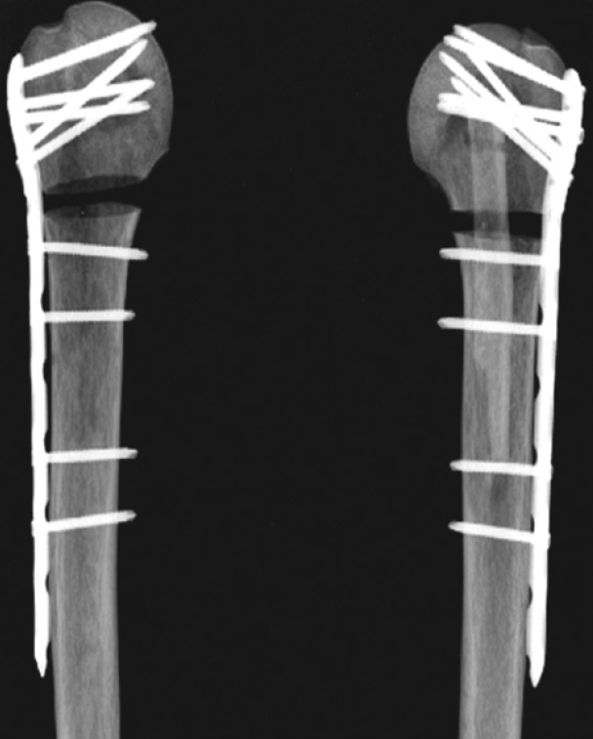
Bae, et al. JBJS-Br, 2011
Biomechanical Study of 14 cadaveric humeri
Cyclical loads of 10 N - 80 N at 5 Hz applied x 1000000 cycles
Immediately after cycling, an increasing axial load was applied
at a rate of displacement of 5 mm/min
Displacement of construct, maximum failure load, stiffness & mode of failure compared
Displacement was significantly less in the LPSG group (p < 0.05)
Maximum failure loads & measures of stiffness were significantly
higher in LPSG group (p = 0.024 & p = 0.035)
Strut graft augmentation significantly increases both
maximum failure load & initial stiffness of construct
compared with locking plate alone

Slide 21
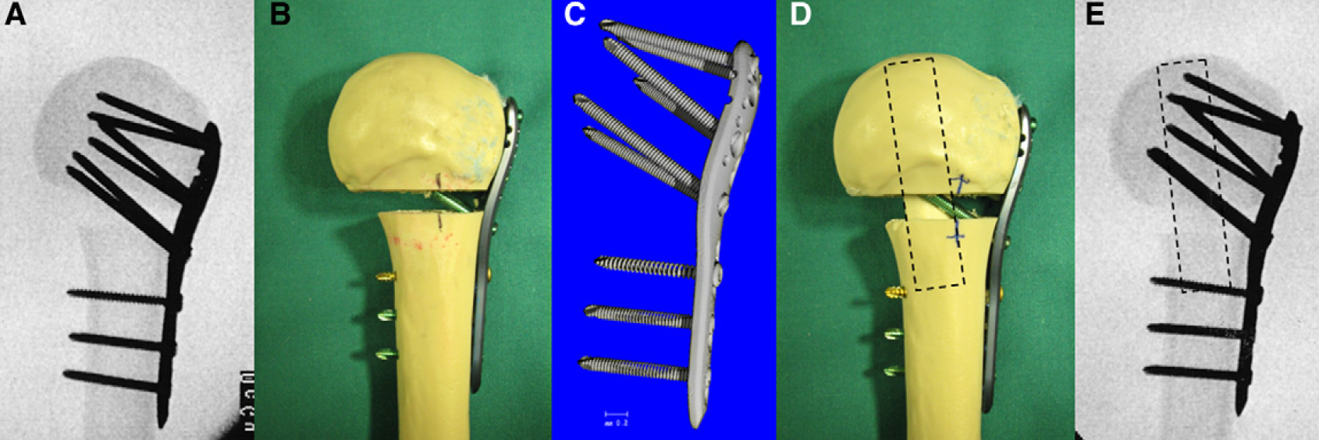
JSES, 2011
Biomechanical study of 20 synthetic composite humeri
5x lower intercyclic motion, 2x lower fragment migration,
2x lower residual plastic deformation

Slide 22
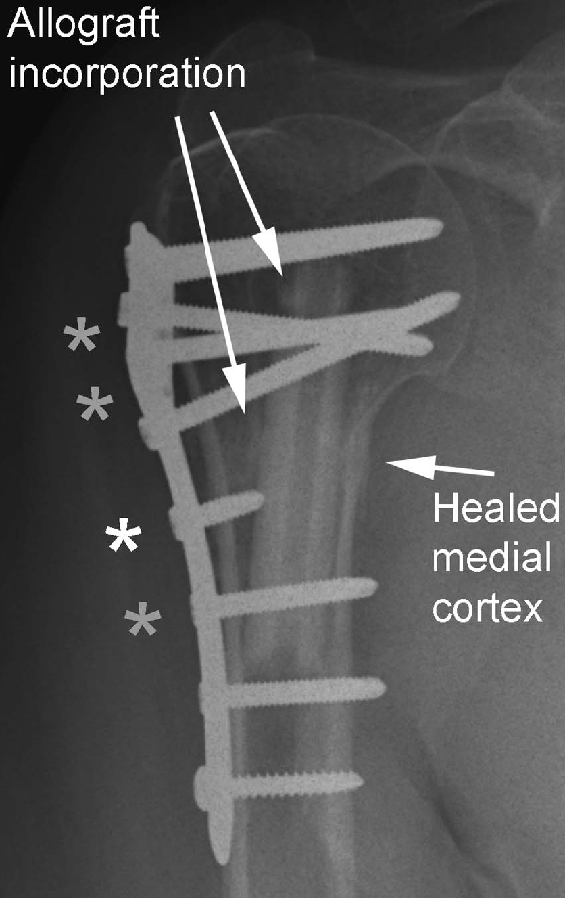
JOT, 2012
Case series of 27 pts with Avg 63-wk F/U
96% maintained original reduction
Avg ht loss of 1.2mm
No implant failures, screw perforations, or AVN
Current Summary in 2013:
Promising Technique:
Enhances construct strength
Facilitates maintenance of reduction
Several Unanswered Questions:
More data needed (sample size, duration of follow-up)
Union/incorporation rate
Complications/infection/unintended consequences
Difficult revision to arthroplasty

Slide 23
Other
Tricks
JSES, 2010
Suture Fixation to Plate is Critical
Facilitates maintenance of reduction
&
Resists Varus Collapse

Slide 24
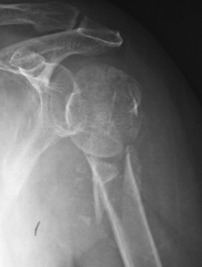
Hemiarthroplasty
Some fractures are not reconstructable
or should not be reconstructed…

Slide 25
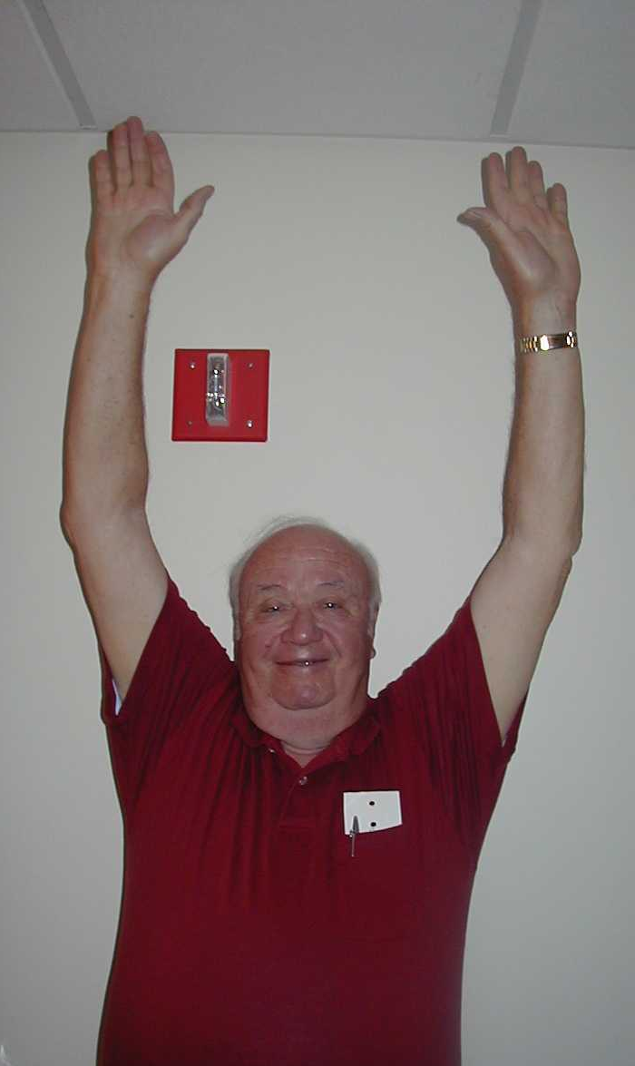
Background
Goals:
Pain Relief
Optimal Shoulder Function
Technical Points:
Restore Proximal Humeral Anatomy
Obtain Tuberosity Healing
Balance Soft Tissues

Slide 26
Three Year Follow-Up

Slide 27
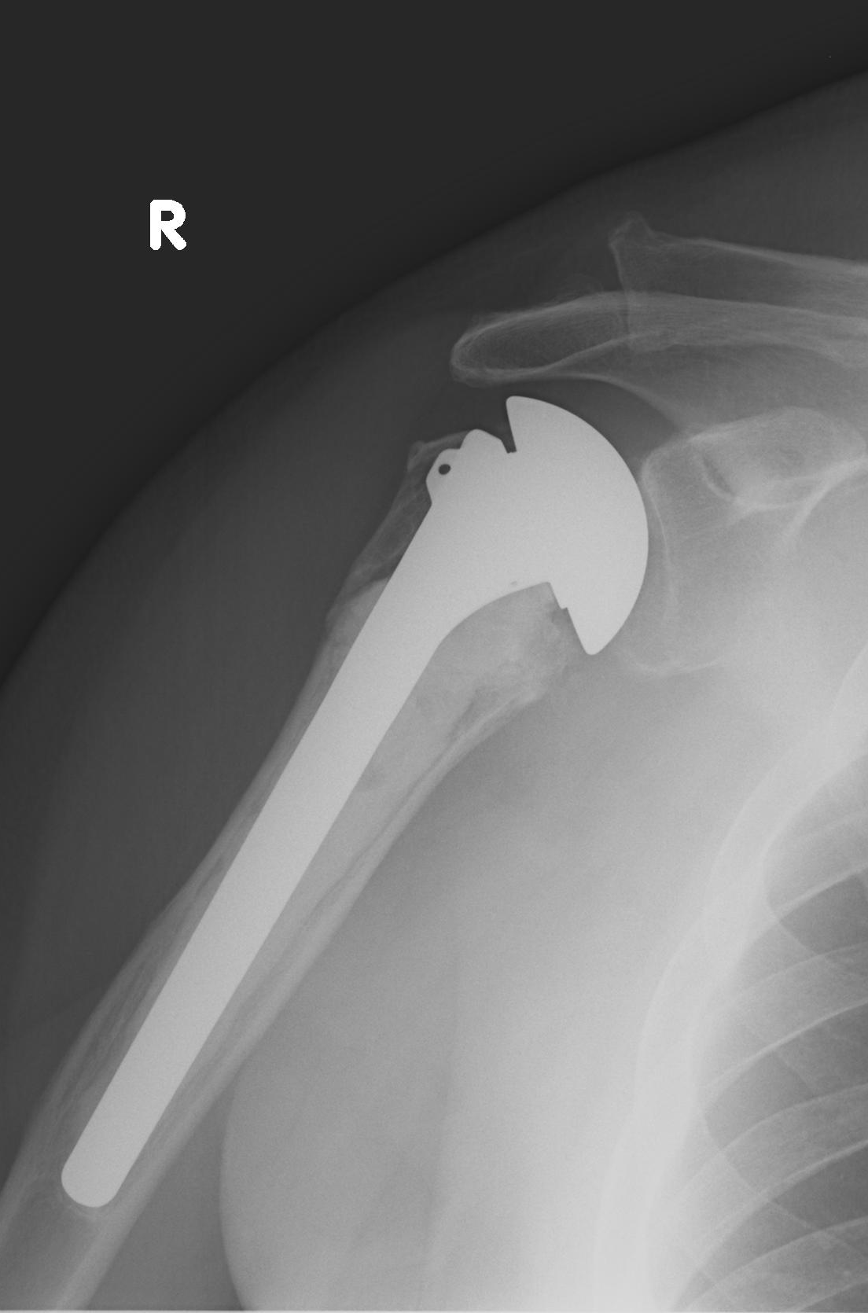

Slide 29
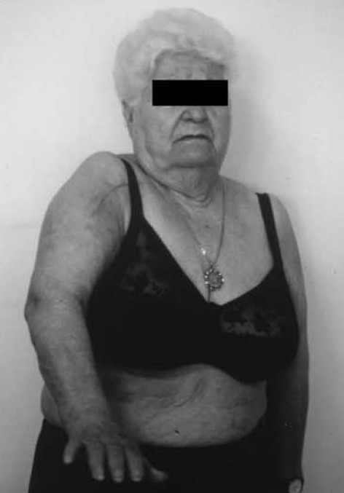
Background
Outcomes:
Pain Relief = “Reliable & Predictable”
Function =
Unpredictable
Influenced by Several Factors:
Age, Sex, Mental Status
Fracture Type, Time to Surgery
Rotator Cuff Status
Duration & Type of Rehabilitation

Slide 30
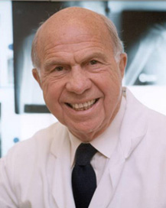
Background
Outcomes Data
90% Excellent & Satisfactory
for 3- & 4-Part Fractures
Neer,
JBJS 1970
Mean age: 55 yrs
Subjective outcomes assessment
Summary: 38% fair or poor results
more reliable in relieving pain
less reliable in restoring function

Slide 31
Background
Outcomes Data
Study | # Pts | Outcomes | Outcomes | Comments
Goldman & Zuckerman et al. (1995) [30 months] | 22 | Avg Forward Elevation = 107 Avg ER = 31 | 27% had activity-related or moderate pain | Poorer elevation was noted in older patients
Zyto & Preston et al, JSES (1998) [39 months] | 27 | Avg Forward Elevation = 70 Avg ER = 45 | Median Constant Score : 46 for 4-Parts & 51 for 3-Parts 33% had moderate or severe pain
Boileau et al. (2002) [27 mos] | 66 | Average Constant Score = 56 Average Forward Elevation = 100 Average ER = 18 87% No Pain or only Mild Pain | Initial Tuberosity Malposition noted in 27% of patients Tuberosity Migration in 50% - correlated w/ poor result | Poor prosthetic or tuberosity position, patient age & gender correlated with migration
Robinson et al. (2003) [13 yr] | 138 | Median Modified Constant Score = 64 at 1 yr Poorer Scores for Fxn, ROM, & Muscle Power | Prosthetic survival = 94% at 10 years 38% had tuberosity migration | Results poorer in elderly pts w/ neuro deficit, eccentrically located prosthesis, or tuberosity migration
Boileau & Krishnan (2005) [1.5yr] | 32 | Mean ASES = 52 (10-100) Mean Active Elevation = 117 (50-165) 13 fair/poor | 52% had forward elevation <120 Mean age = 75 36% in subgroup had tuberosity nonunion | Higher ASES, Elevation, & better pain score with younger age & tuberosity healing
Gronhagen et al., JSES (2007) [4.4 yr] | 46 | Mean 15% - Moderate Pain 61% - Mild Pain 24% - No Pain | Mean Constant Score = 42 -Significantly higher in pts <60 | Good Pain Relief Moderate Function Poor Strength
Pain = 15 – 61%
Tuberosity Migration or Malposition = 27-50%
Follow-Up = 2.5 – 13 yrs
Avg Forward Elevation = ~70-117°
Average Constant Score = 42-64
Poor Outcomes – Age, Tuberosity Position, & Prosthetic Position

Slide 32
JSES, 2011
Level I Randomized Study of 55 pts mean age 77 y/o w/ 4-pt displaced fxs
2-year outcome after randomized to hemiarthroplasty or nonop tx
Follow-up exams @ 4/12/24 mos
Outcome Measures: HRQoL, EQ-5D, DASH, Constant
Results:
HRQoL was significantly better in HA group
EQ-5D index score 0.81 compared to 0.65 (P=.02).
DASH & pain assessment both favorable in HA group,
DASH score 30 vs 37 (P =.25) & VAS/pain of 15 vs 25 (P =.17).
No significant differences regarding Constant score or ROM
Results demonstrated a significant advantage in QOL with HA
The main advantage of HA appeared to be less pain

Slide 33
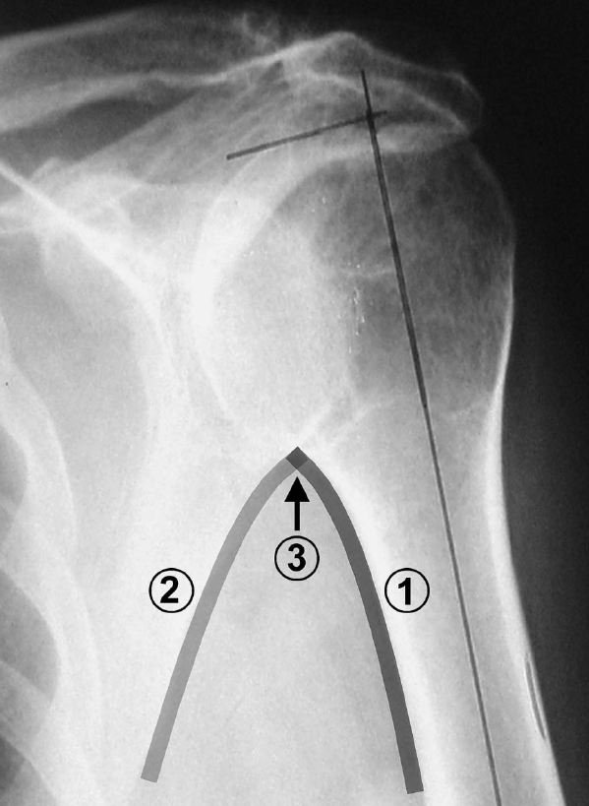
Fracture Classification
Radiographic Evaluation
Fracture Anatomy:
Surgical Neck location
Determining length
View calcar contour
“Gothic Arch”
Krishnan & Boileau, TSES, 2005

Slide 34
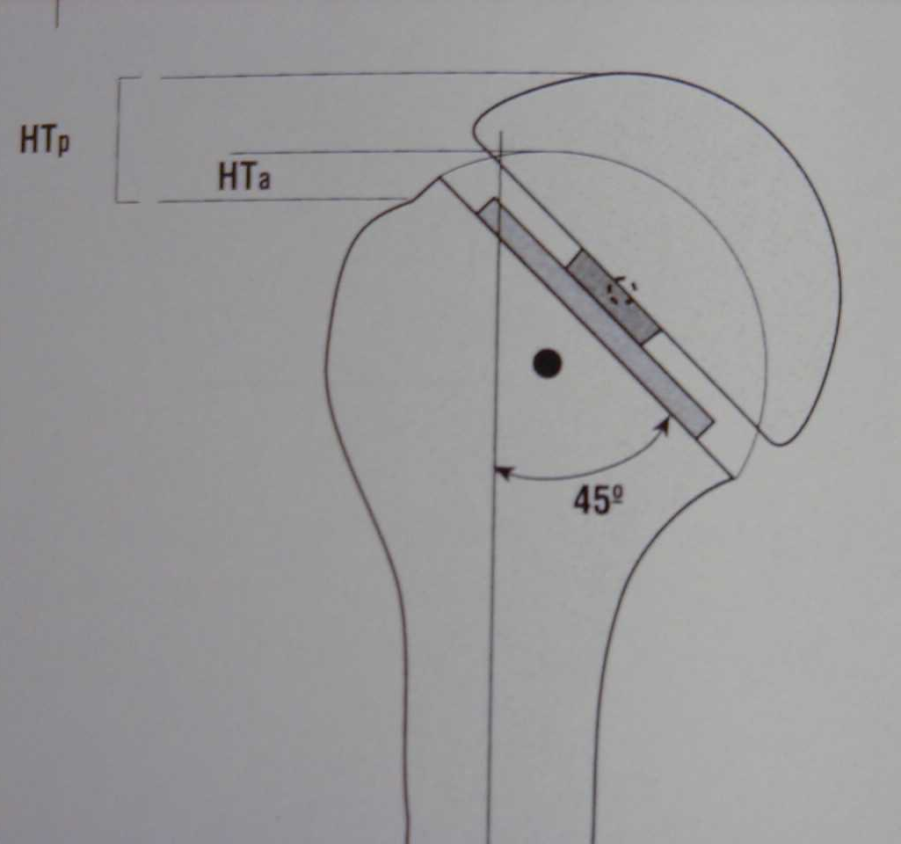
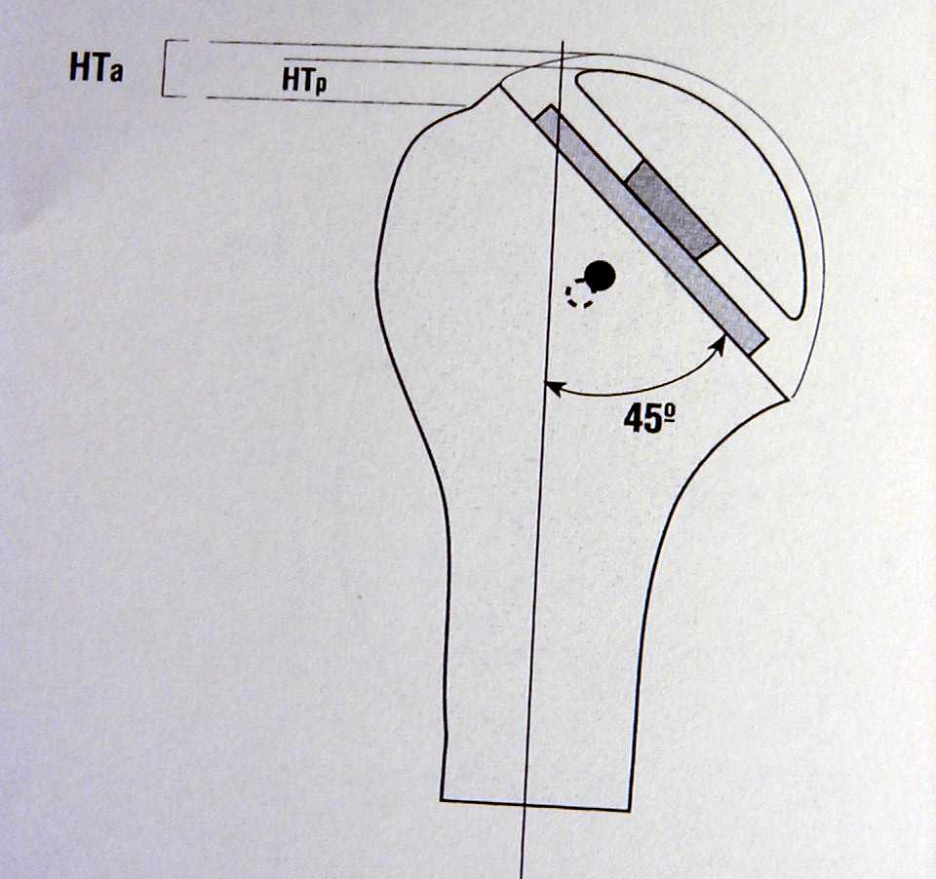
Prosthetic Considerations
Effect of Head Size
Large Head
Small Head
Significantly alters
Center of Rotation

Slide 35
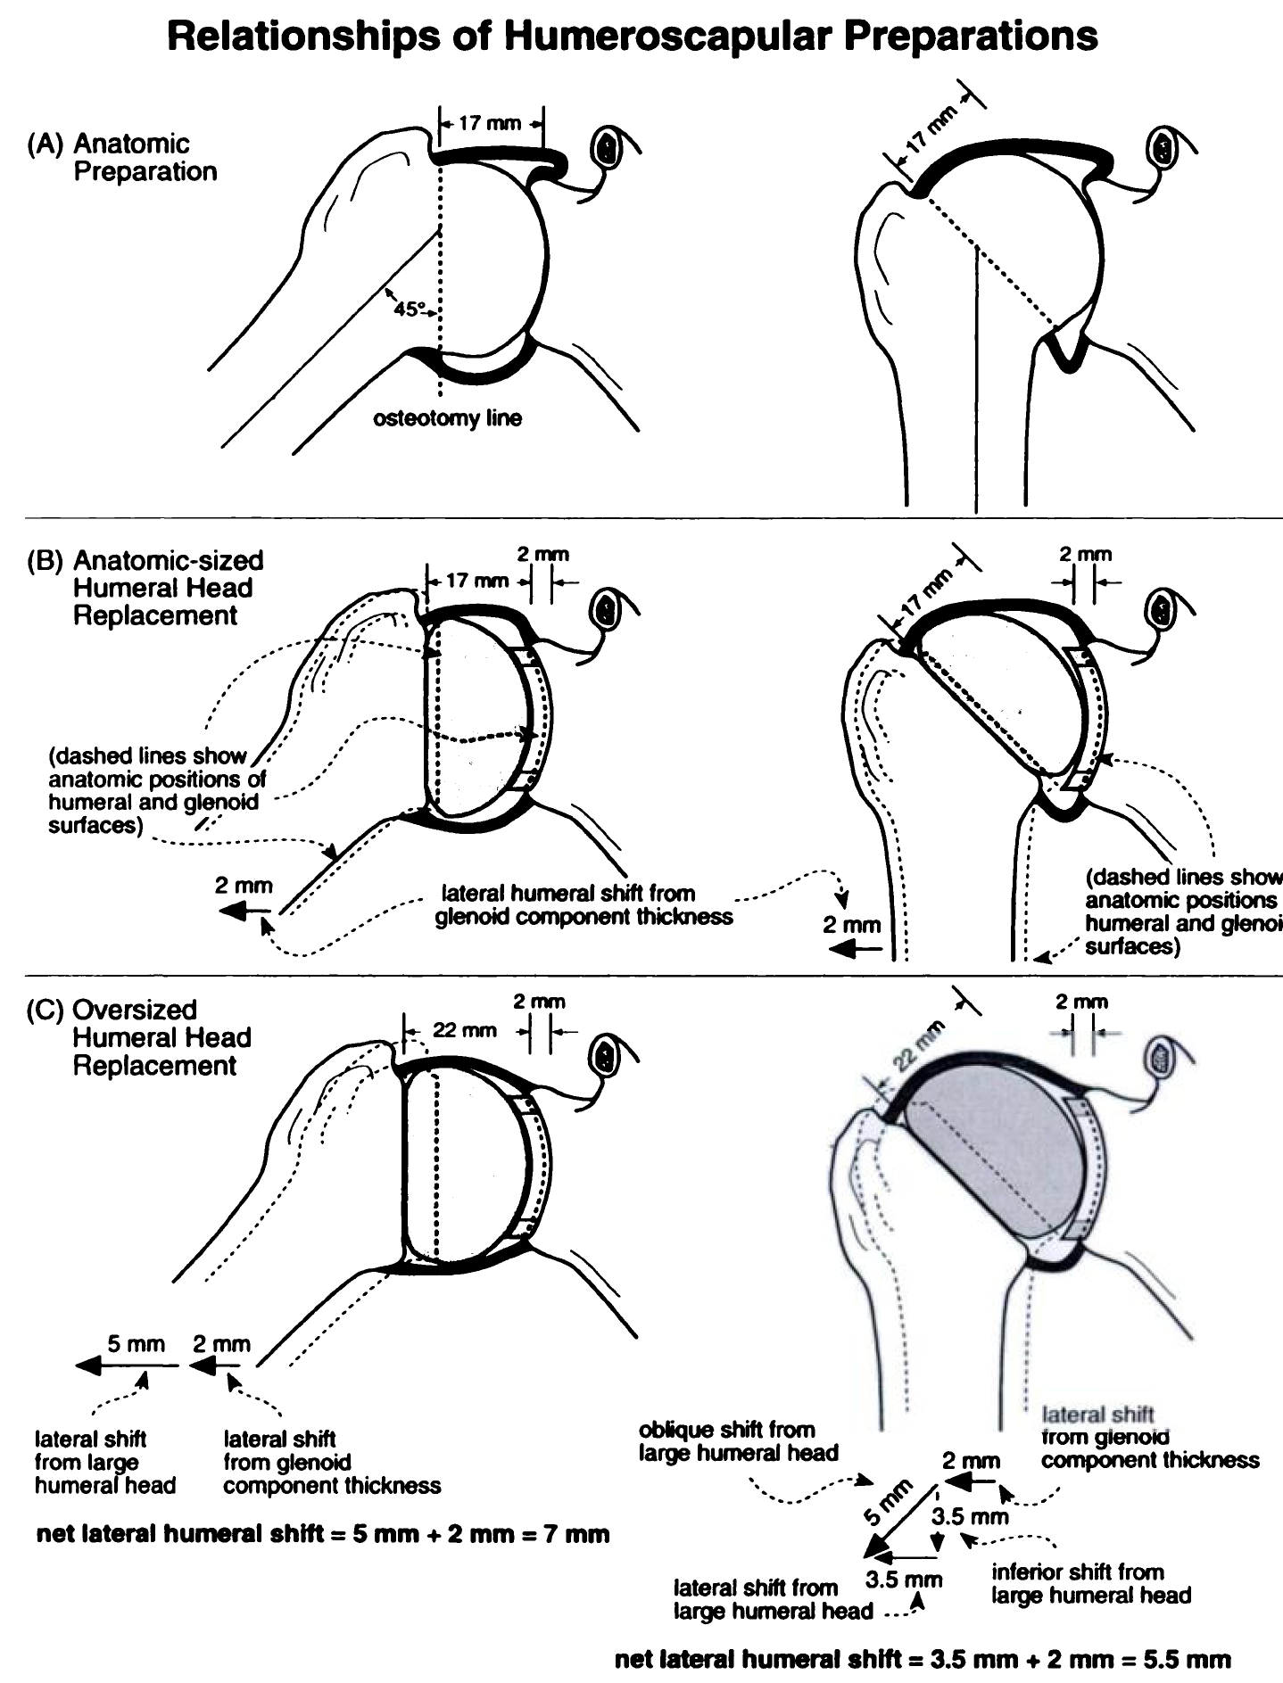
Prosthetic Considerations
Effect of Head Size
Increasing humeral head
thickness by only 5 mm:
Decreases GH motion by
20-30 degrees
Increases obligate
translations earlier in ROM
Significantly alters
glenohumeral kinematics
Avoid oversizing head &
over-stuffing joint
Harryman, JBJS, 1995

Slide 36
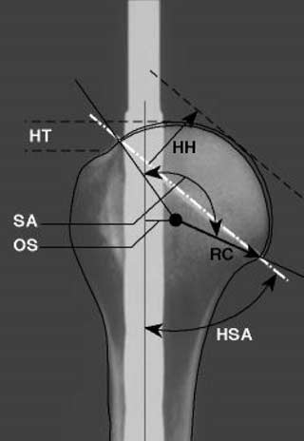
Proximal Humeral Anatomy
Highly variable with regard to:
Retroversion (~0-55 degrees)
Head-Shaft Angle (~30-55 degrees)
Offset (Medial & Posterior)
Radius of Curvature (~20-30mm)
Head Height (~5-10mm)
Difficult to reconstruct
Understand Nml Values as guidelines
Pearl, Volk, JSES 1996
Boileau, Walch JBJS-B 1997
Robertson, Yamaguchi, JBJS-A 2000
Hernigou et al., JBJS 2002

Slide 37
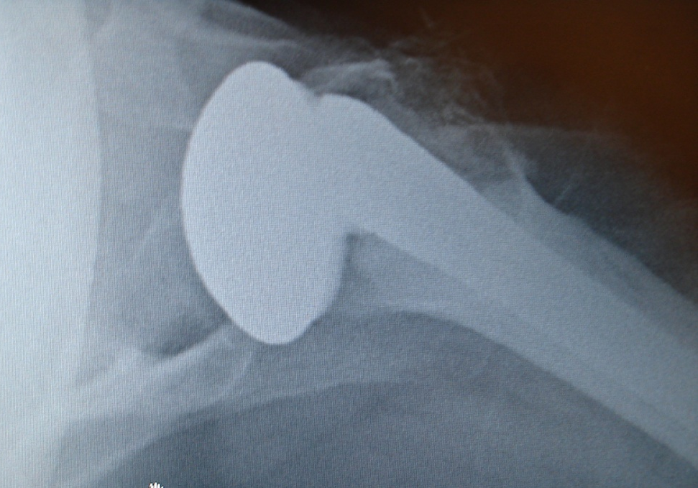
Proximal Humeral Anatomy
Establishing Correct Version
Retroversion:
avg 19°, range: 9-31° [-6 - 50° in previous studies]
Establishing Proper Version is Essential for Stability & Function:
Tendency is to increase retroversion for decreased risk of anterior instability
Robertson, Yamaguchi, JBJS-A 2000

Slide 38
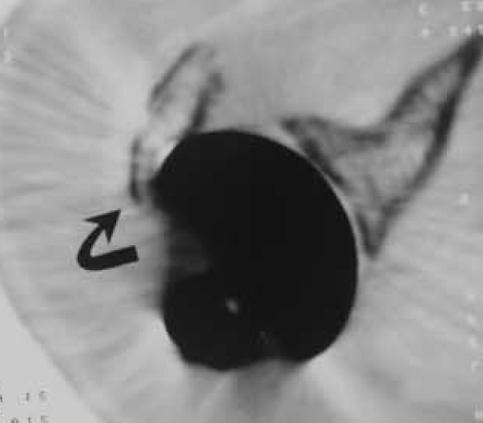
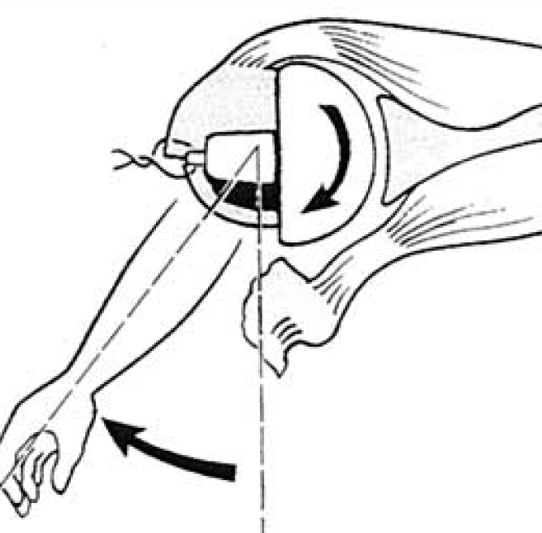
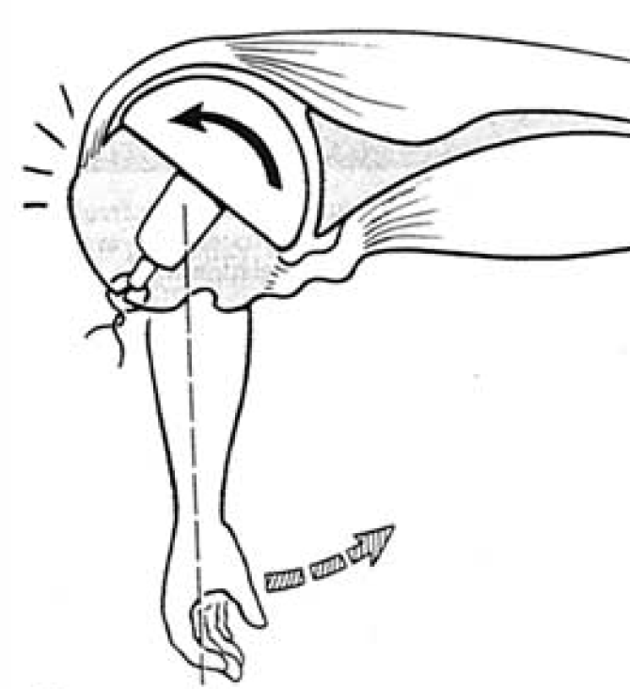
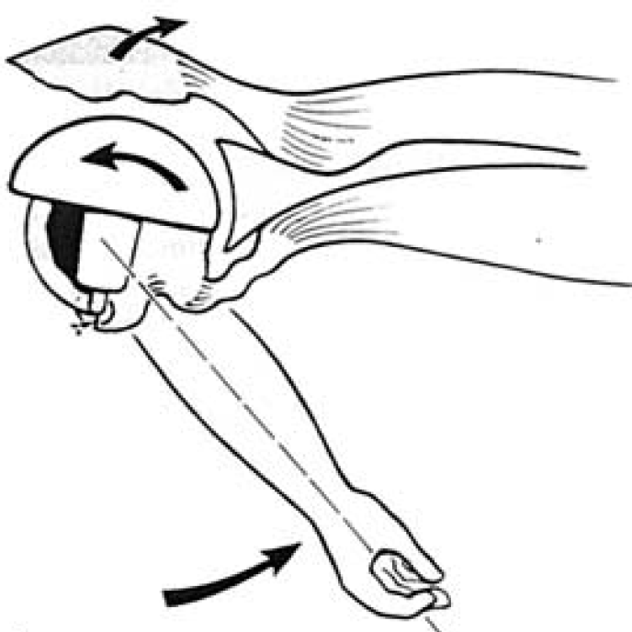
Technical Considerations
Effect of Incorrect Version
Too Anteverted
Too Retroverted
Boileau & Walch, JSES 2002

Slide 39
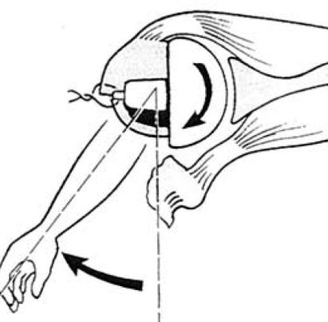
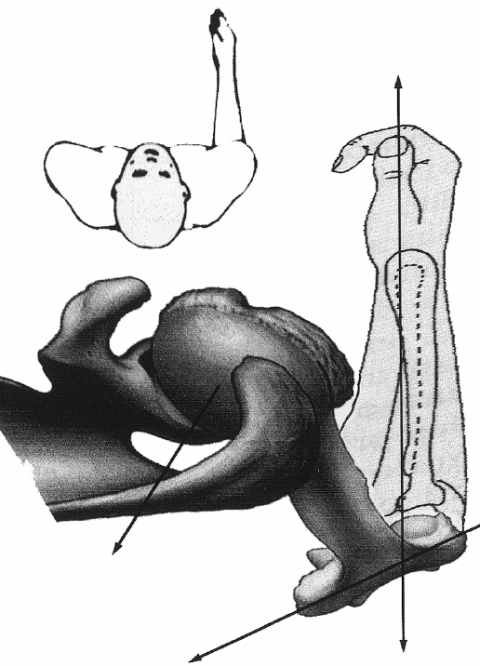
Technical Considerations
Establishing Correct Version
Too Anteverted
Technical Points:
Bicipital Groove
Forearm
Axis more closely approximates
preop CT measurement than
Transepicondylar axis (P=0.02)
Transepicondylar Axis
Too Retroverted
Fracture Jig
Tillet, JSES 1993
Hempfing, Leunig, & Hertel et al., JSES 2001
Boileau & Walch, JSES 2002
Hernigou, et al., JBJS 2002

Slide 40
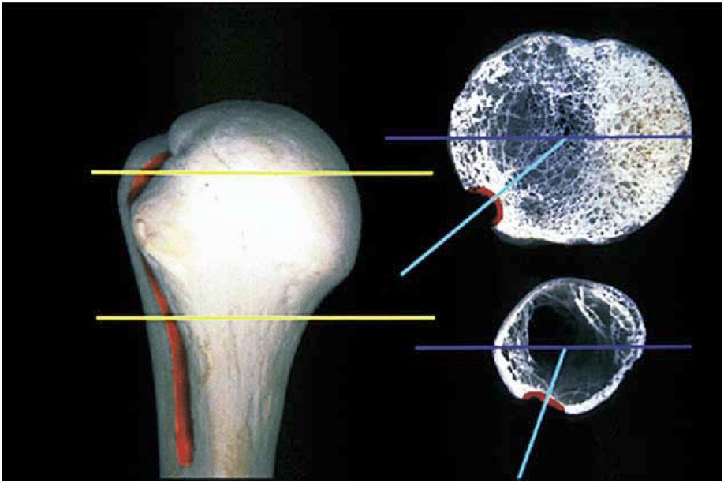
Technical Considerations
Bicipital Groove
Anterior to head center
Anterior to keel location
Location dependant on
distance from anatomic
neck
Variable retroversion distal
Boileau & Walch, JSES 2002

Slide 41
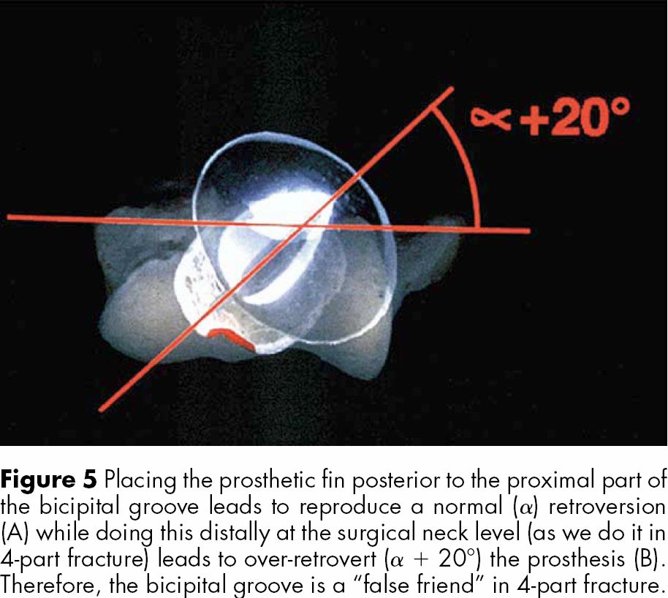
Technical Considerations
Bicipital Groove
Boileau & Walch, JSES 2002

Slide 42
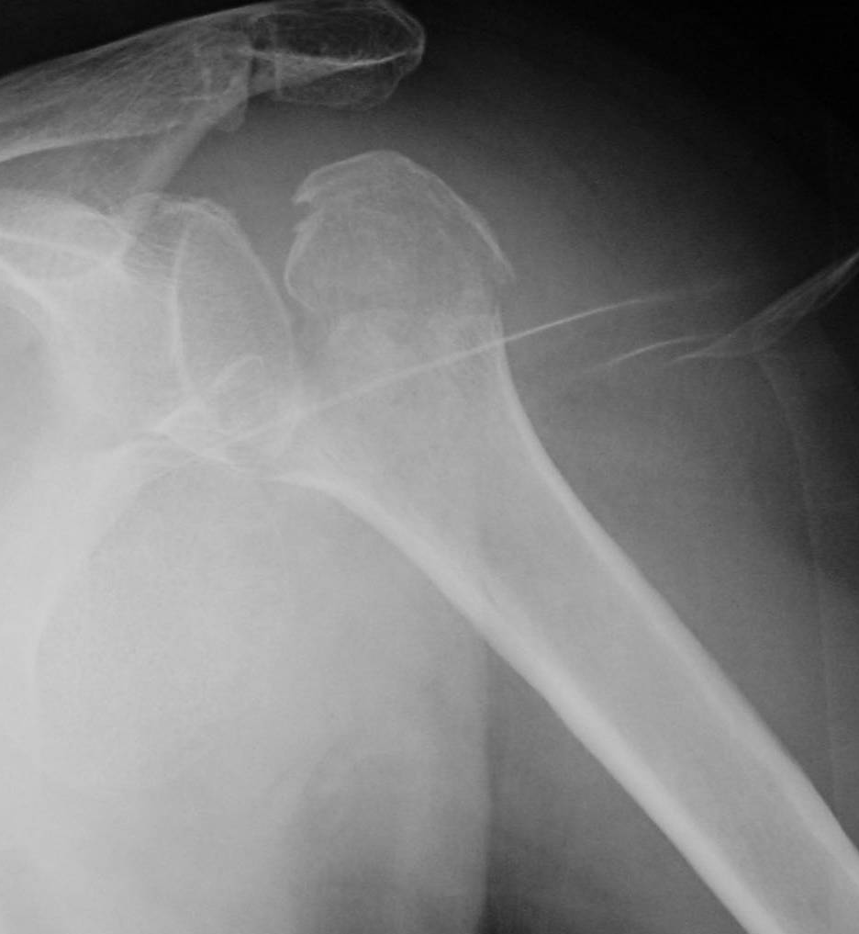
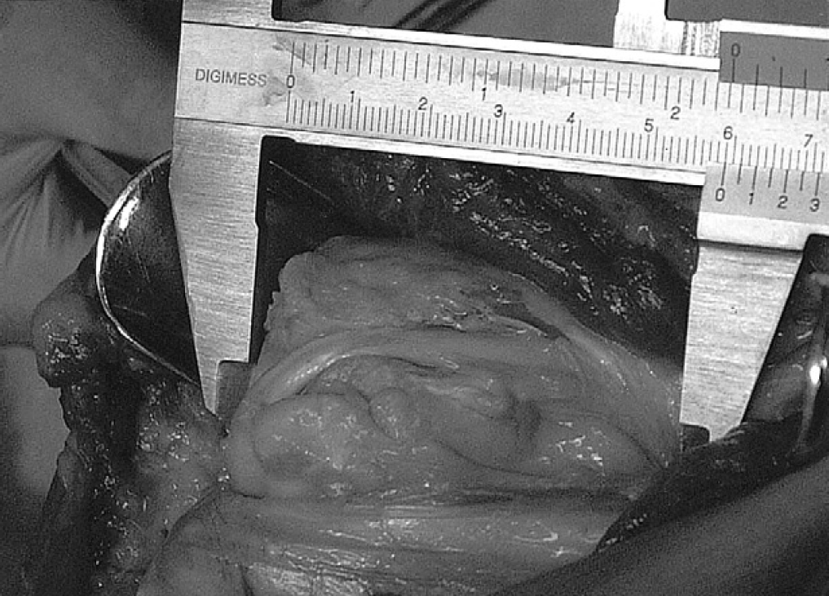
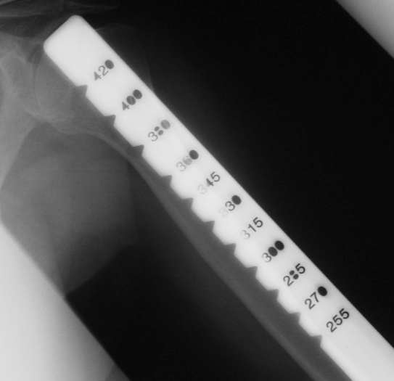
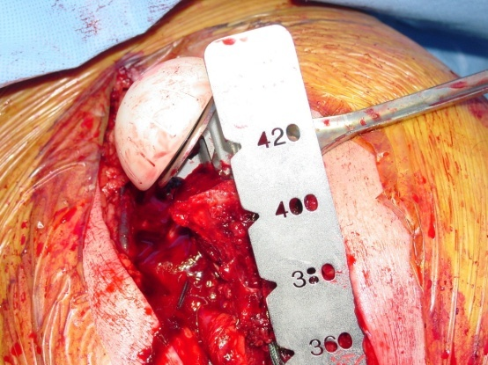
Technical Considerations
Establishing Height
Ray-Tech Sponge in
Metaphysis & Trial
Contralateral Radiograph
& Intraoperative Ruler
Long Head Biceps Tension
Pectoralis Major Tendon
5.6 cm +/- 5mm
Fracture Jig
Tornier
Intramedullary Sleeve
Biomet, Zimmer
Gerber, AAOS 2004
Murachovsky & Warner, JSES 2006

Slide 43
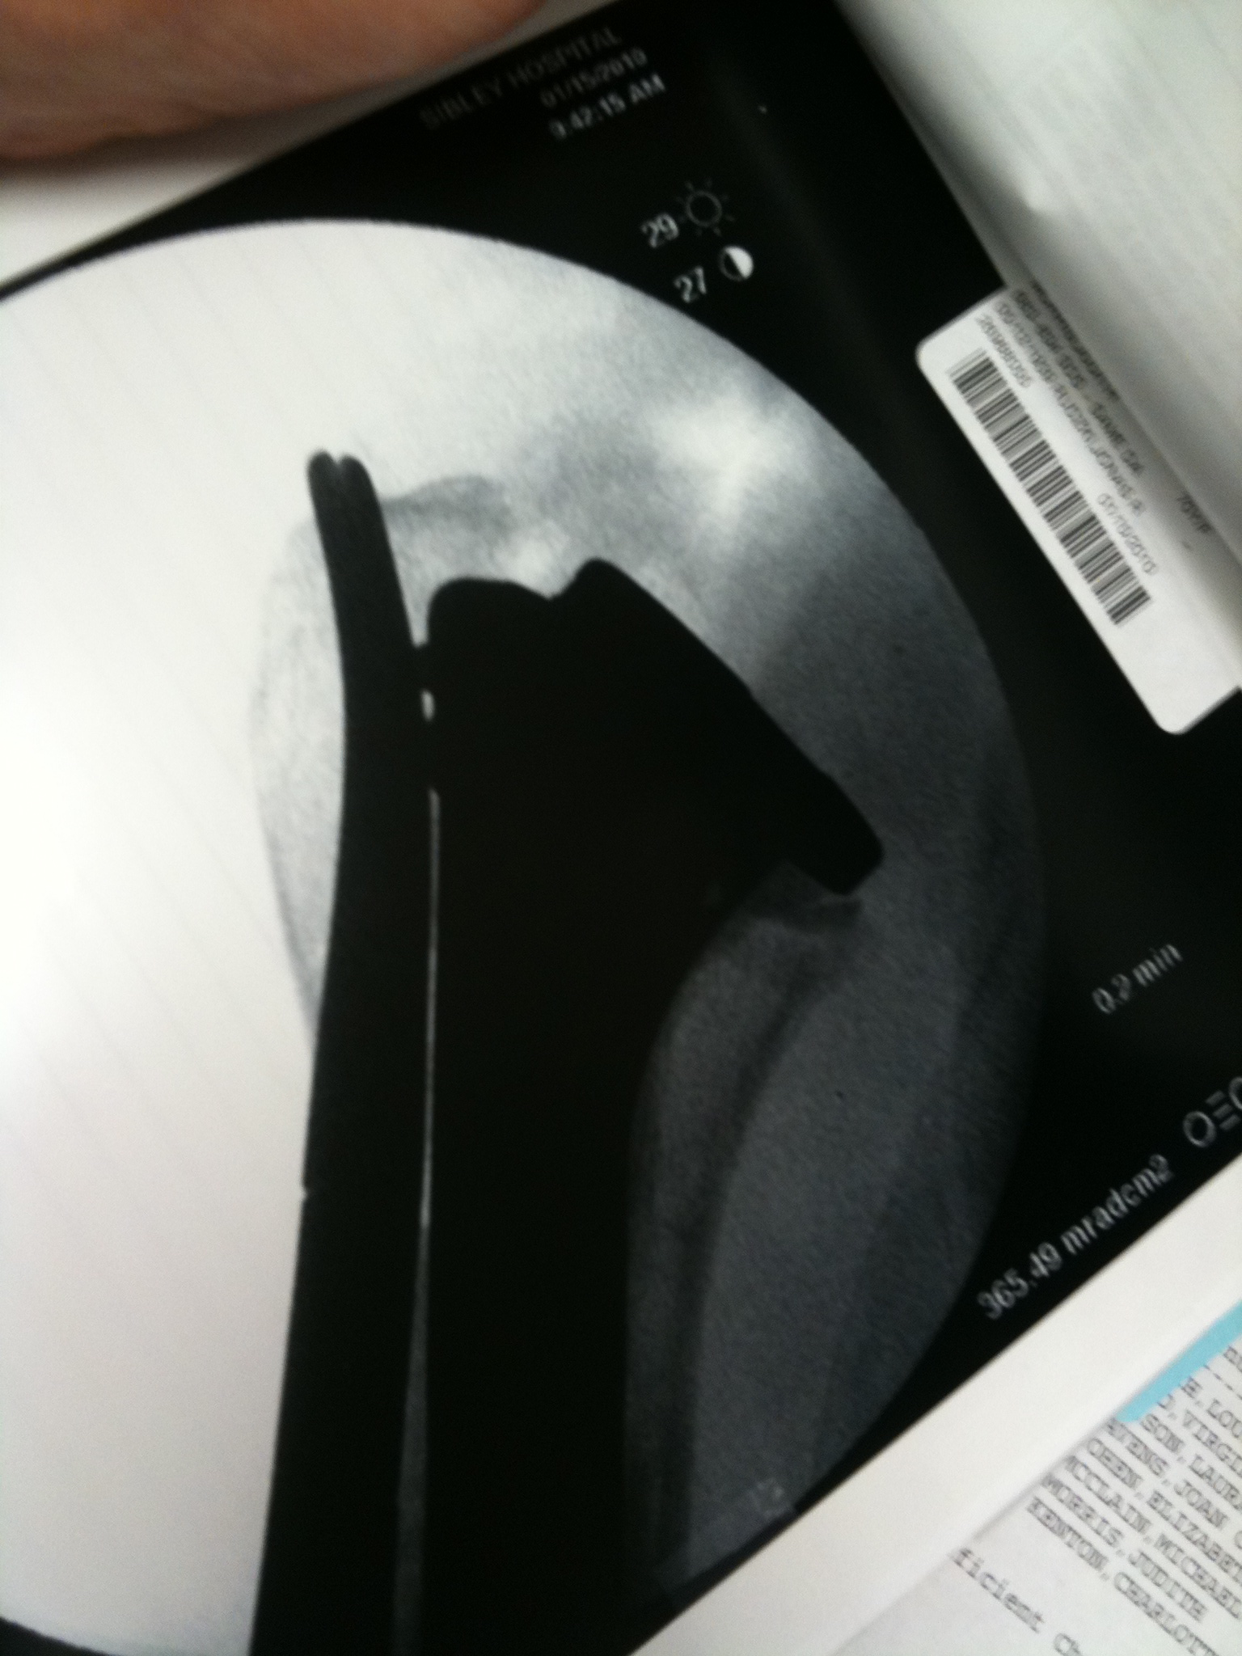
Technical Considerations
Establishing Height
Quick
Fluoro
Shot

Slide 44
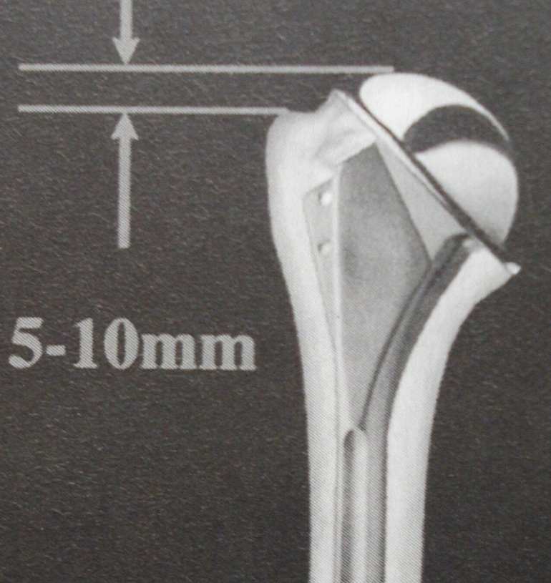
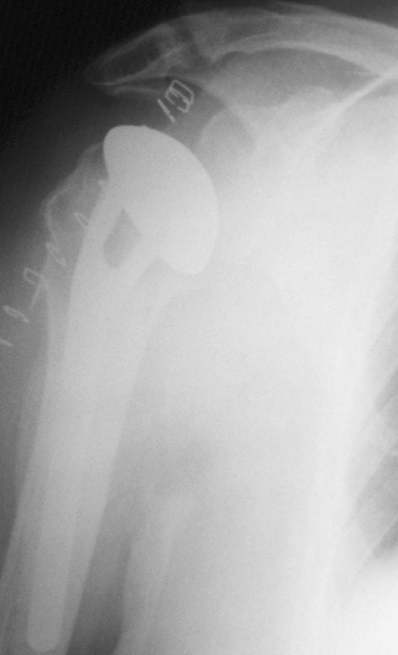
Technical Considerations
Tuberosity Position
Prosthetic Height & Tuberosity Position
Challenging:
Landmarks compromised
Anatomic variability
Iannotti et al. JBJS 1992
8 mm +/- 3 mm
Critical for:
Stability
Motion
Tuberosity Healing
?
Robertson & Yamaguchi
et al. JBJS 2002
6 mm +/- 2 mm

Slide 45
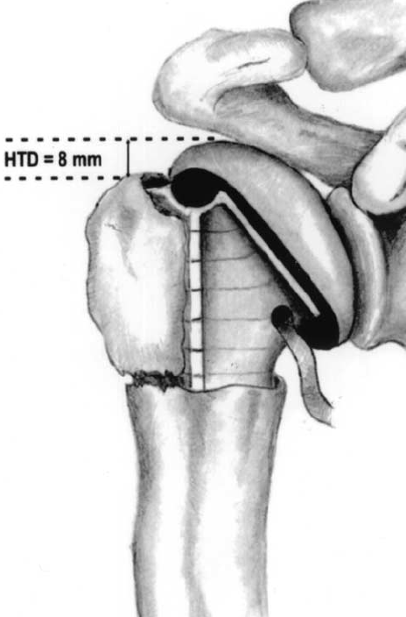
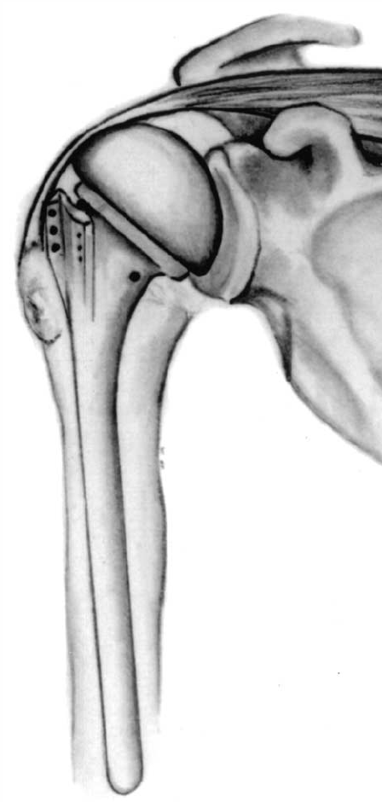
Technical Considerations
Tuberosity Position
Height Relative to Humeral Head
Avoid over-reduction
of greater tuberosity
Huffman, JSES 2008

Slide 46
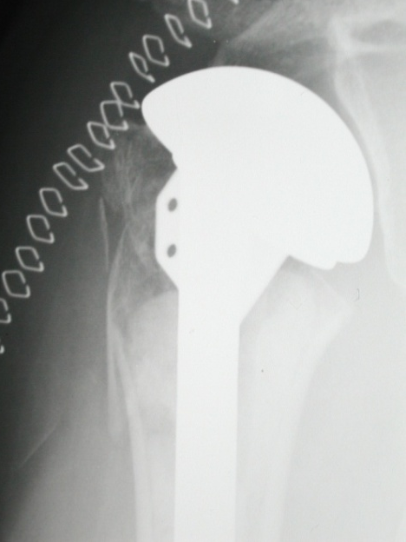
Technical Summary
Review
Assess calcar
Re-establish height
Avoid excessive retroversion
Caution with bicipital groove
Restore head thickness/height
Template from native head
Avoid over-stuffing for stability
Secure tuberosity fixation
Appropriate tuberosity position (6-8mm)
Avoid over-reduction of tuberosities

Slide 47
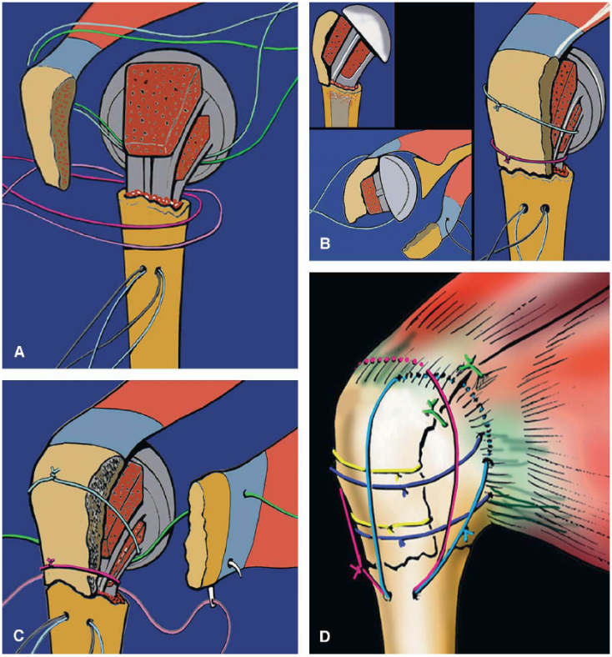
Rehab Considerations
Tuberosity Fixation
Primary Concern:
Tuberosity Healing
Would like to avoid stiffness
Current Protocol for 1st 6 Wks:
Passive Supine Forward Elevation
Passive ER to 20-30 degrees
Avoid IR for 2-3 months
Agorastides, et al. – JSES, 2006: Early versus late mobilization after hemiarthroplasty for proximal humeral fractures
Randomized controlled trial comparing 2- vs. 6-week mobilization after
shoulder hemiarthroplasty for acute 3- & 4-part fractures
Decreased incidence of tuberosity migration in group undergoing
late mobilization (not statistically significant)

Slide 48
Complications
Anterosuperior Escape
Infection
Tuberosity Migration / Nonunion
Nerve Injury / Pseudoparalysis
Glenoid Erosion

Slide 49
Revisions & Difficult Cases
Complex Cases
Options Include:
Revision to Hemiarthroplasty
High rate of complications related to
tuberosities & tuberosity healing
Boileau, JSES 2001; Flatow, JSES 2006
Revision to Reverse Shoulder Arthroplasty
High rate of complications related to infection
& instability
Resection Arthroplasty

Slide 50
What is the role for Reverse Shoulder Arthroplasty?

Slide 51
Emerging Concepts
29 patients
Mean Age: 69
Improvements in: Avg ASES score (22.3 preop to 52.1; p < 0.001)
Avg ASES pain score (12.2 to 34.4; p < 0.001)
Avg ASES function score (10.1 to 17.7; p = 0.058)
Forward flexion (38.1° to 72.7°; p < 0.001)
Abduction improved (34.1° to 70.4°; p < 0.001)
Overall complication rate was 28%
79% patients rated outcome as excellent/good/satisfactory
21% - dissatisfied
Salvage-type solution to problem of failed hemiarthroplasty due
to glenoid arthritis & rotator cuff deficiency following tuberosity failure
JBJS, 2007

Slide 52
Level IV Retrospective Review of 40 pts displaced 3 & 4-pt fractures treated with arthroplasty 1996 - 2004.
21 – hemiarthroplasty 19 - reverse prosthesis Mean ~14 month Follow-Up
Reverse prosthesis group showed better results:
Abduction (mean = 91◦ versus 60◦)
Forward elevation (mean = 97.5◦ versus 53.5◦)
Constant score (mean = 53 versus 39)
Rotation was better in the hemiarthroplasty group (minor)
DASH scores were identical in both groups.
Inferior rotation & concerns for notching & durability w/ Reverse
~15 Tuberosity malposition or failure w/ Hemiarthroplasty

Slide 53
Level III, Retrospective Case-Control Study
41 patients, with a mean age at trauma of 76.9 yrs
Mean followup = 24 months
Tuberosities were repaired in 27 patients & removed in 14 cases
JSES, 2013
Two-thirds of the repaired tuberosities consolidated in anatomic position. We compared a group with tuberosity healing in anatomic position versus a group without repair & with malunion or nonunion of the tuberosities.
In the first group, all sectors of motion, especially external rotation (49 vs 10),
were improved and both Constant (65 vs 50) & DASH scores (30 vs 40) were significantly better.

Slide 54
Why use a Reverse Arthroplasty for Failed ORIF?
Gerber et al., JSES, 2013

Slide 55
Reverse Arthroplasty for Proximal Humerus Fracture

Slide 56
Results: Fourteen studies fulfilled all inclusion and exclusion criteria and were included. Patients were followed for a frequency-weighted mean of 43.5 months in the reverse arthroplasty group and 31.1 months in the hemiarthroplasty group (p = 0.228).
Subjective outcomes (including the Constant score, Constant pain subscore, & ASES score) and ROM parameters (FE, Abdxn, & ER) were similar between the two groups.
Compared with hemiarthroplasty, reverse arthroplasty was associated with 4.0 times greater odds of a postoperative complication.
JBJS, 2013

Slide 57
Case Example: 85 y/o Female Malunion

Slide 58
Case Example: 88 y/o Female
Varus Extension
Disrupted Medial Hinge
Osteoporosis & Extensive Comminution

Slide 59
Current Concepts in Treatment of Proximal Humerus Fractures
Thank You
J.R. Rudzki, MD, MSc
Washington Orthopaedics & Sports Medicine
Clinical Assistant Professor
Dept. of Orthopaedic Surgery
George Washington University School of Medicine
Washington, DC
Galway University Hospitals
Galway, Ireland
May 24, 2013

Slide 61
Kralinger et al.,
JBJS-Br, 2009
Biomechanical study of 20 cadaveric humeri
Evaluated medial periosteal disruption at calcar with 20 mm/min
load on head (medial or lateral)
Periosteal rupture starts after displacement of head fragment > ~3 mm,
& is completed after ~ 34 mm displacement

Slide 62
Prosthetic Considerations
Abnormal Recreation of Anatomy:
Ballmer, et al, JSES 1993
small changes in anat: impt biomech consequences
Harryman, et al, JBJS 1995
head thick increase 5 mm: significantly reduced ROM
Jobe, Iannotti, JSES 1995
5 mm decrease in thickness: decreased arc 24°
Pearl, JBJS 1999
2D analysis of arthroplasty systems
Huffman, JSES 2008
>10-20mm of inferior tuberosity placement significantly
alters glenohumeral kinematics

Slide 63
JBJS, 2010
Cadaveric study of 12 matched pairs w/ Gadolinium MRI & polymer injection
Posterior humeral
circumflex artery
64% of Blood Supply
to Humeral Head

